Slide 1
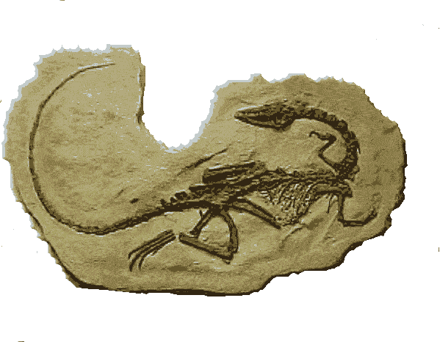
Evidence for Evolution
Why are Darwin’s ideas now widely accepted?

Slide 2
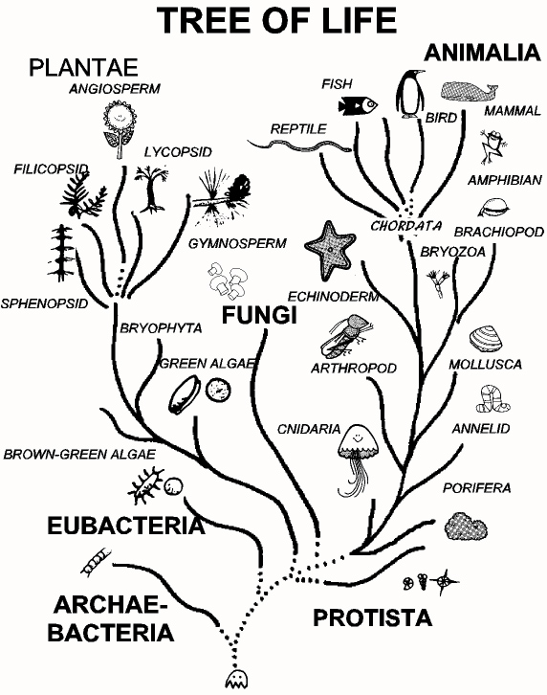
Common Descent
The central idea of biological evolution is that all life on Earth shares a common ancestor, just as you and your cousins share a common grandmother.

Slide 3
Decent with modifications
Organisms that were once the same have now grown “apart” and have become different organisms.
Overtime natural selection produces organisms that have different structures.
These changes increase a species’ fitness in their environment.
10

Slide 4
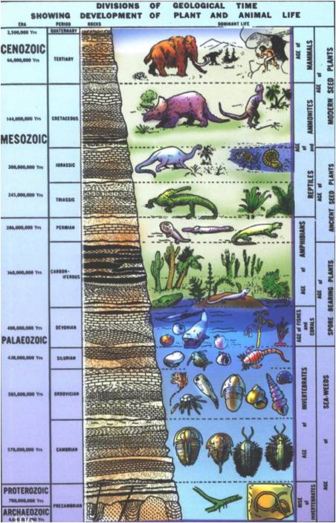
I. Fossil Record
Fossils are the Trace remains of organisms that lived long ago.
By looking at fossils we can infer what life looked like in the past

Slide 5
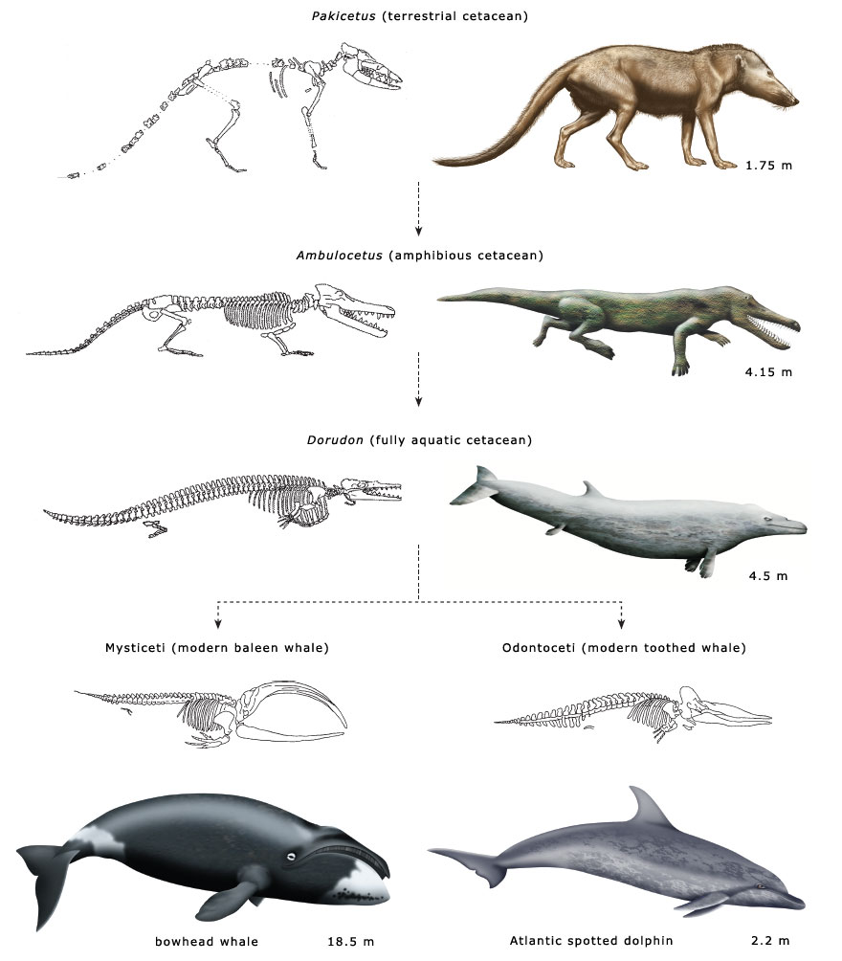
Darwin hypothesized that whales might have evolved form a mammal that lived on land
Darwin predicted that intermediate forms between groups of species might be found
New fossils have been found to support that idea

Slide 6
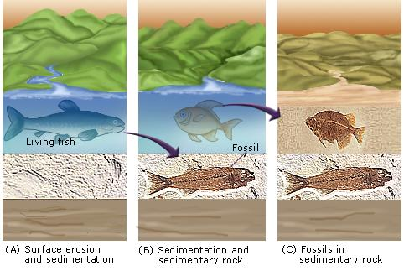
It takes very specific conditions to create fossils so the record of life on earth is incomplete.

Slide 7
II. Biogeography (Geology)
Biogeography is the study of the location of organisms around the world.
Darwin observed that animals in similar environments, but in different parts of the world, share similarities

Slide 8
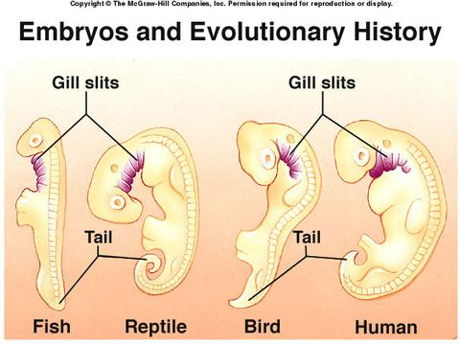
III. Developmental biology
Embryology: species that have similar patterns and structures in embryonic development.
Evidence for a common ancestor

Slide 9
What will I grow up to be?

Slide 10
A little older…

Slide 11
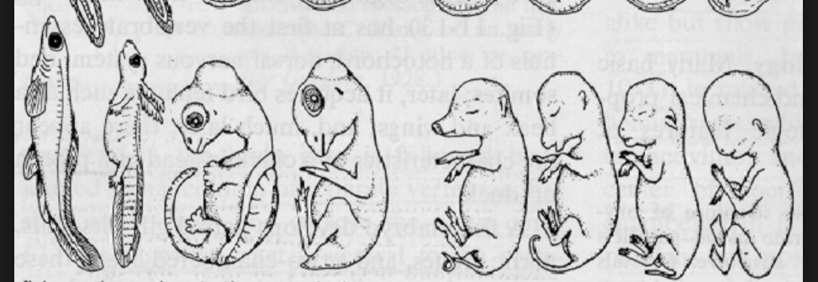
Can you tell now?

Slide 12
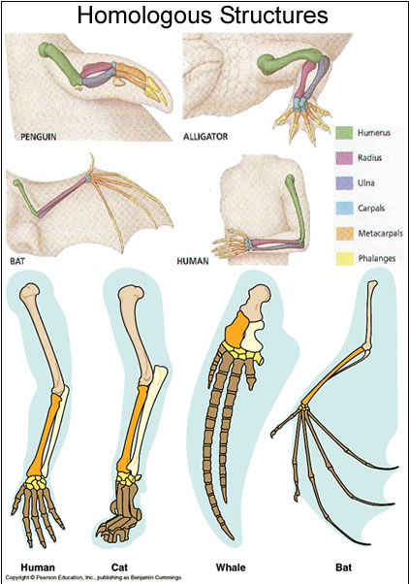
IV. Anatomy
Homologous structures describe a characteristic that is shared by a group of species because it is inherited from a common ancestor.
Example: hand and arm bones of mammals

Slide 13
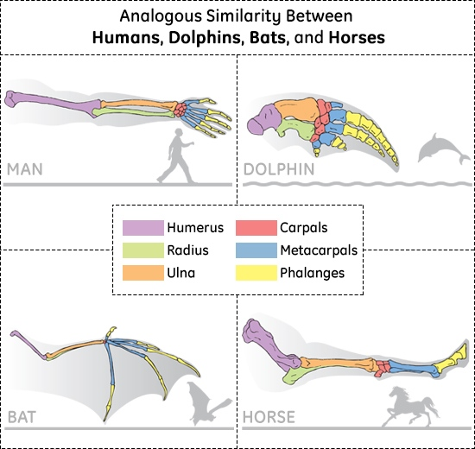
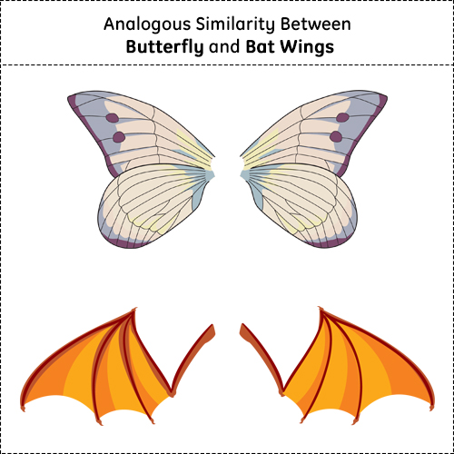
Analogous Structures:
Organisms do not have a common ancestor, yet still evolved characteristics with similar functions.

Slide 14
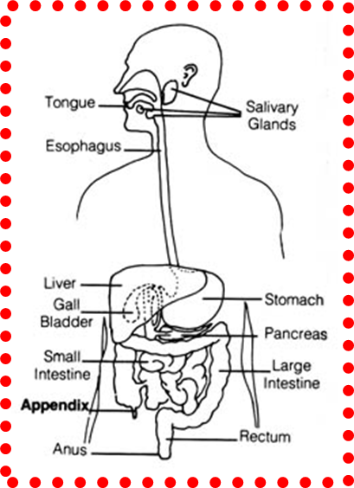
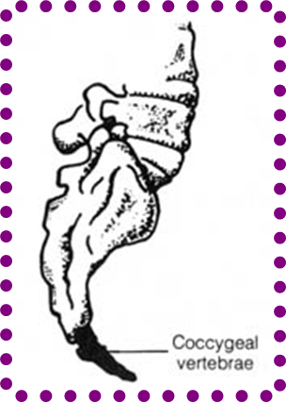
V. Vestigial structures
Structures that once served a purpose for a common ancestor.
Example: snake or whale pelvis. Appendix. Wisdom teeth.

Slide 15
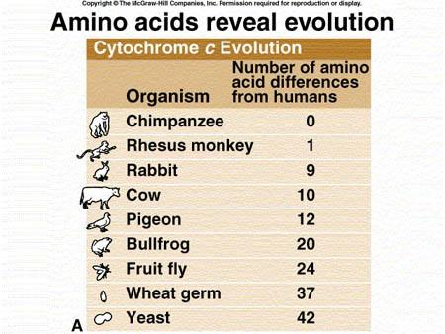
V. Biochemistry
A comparison of DNA or amino-acid sequences show that some species are more genetically similar than others. This suggests a common ancestor.

Slide 16
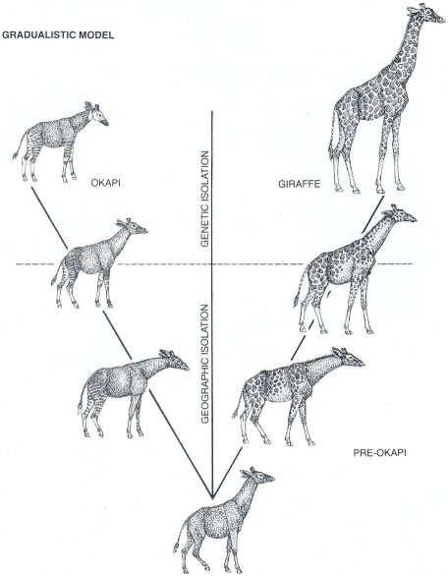
Gradualism
Model (Darwin) that argues that evolution is a slow build up of many large changes

Slide 17
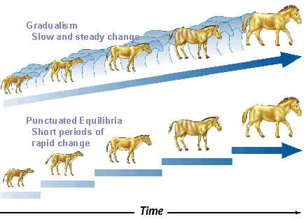
Punctuated equilibrium
Modern biologists argues that some species may “suddenly” appear.

Slide 18
