Slide 1
Chapter 9: Studying Human Populations

Slide 2
Studying Human Populations
Demography is the study of the characteristics of populations, especially human populations.
Demographers study the historical size and makeup of the populations of countries to make comparisons and predictions.
Demographers also study properties that affect population growth, such as economics and social structure.

Slide 3
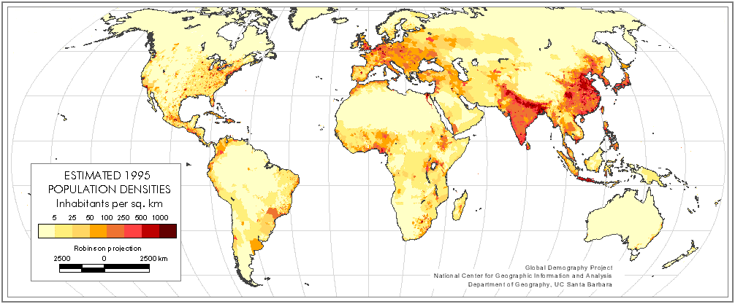

Slide 4
Studying Human Populations
Countries with similar population trends are often grouped into two general categories: developed and developing countries.
Developed countries have higher average incomes, slower population growth, diverse industrial economies, and stronger social support systems.
Developing countries have lower average incomes, simple and agriculture-based economics, and rapid population growth.

Slide 5
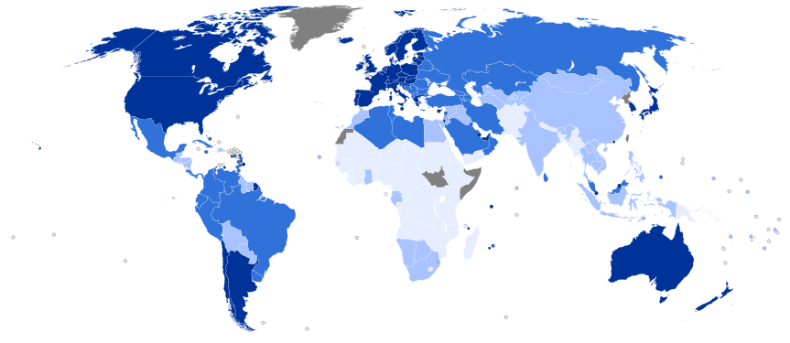

Slide 6
The Human Population Over Time
The human population underwent exponential growth in the 1800s, meaning that the population growth rates increased during each decade.
These increases were mostly due to increases in food production and improvements in hygiene that came with the industrial and scientific revolution.
However, it is unlikely that the Earth can sustain this growth for much longer.

Slide 7
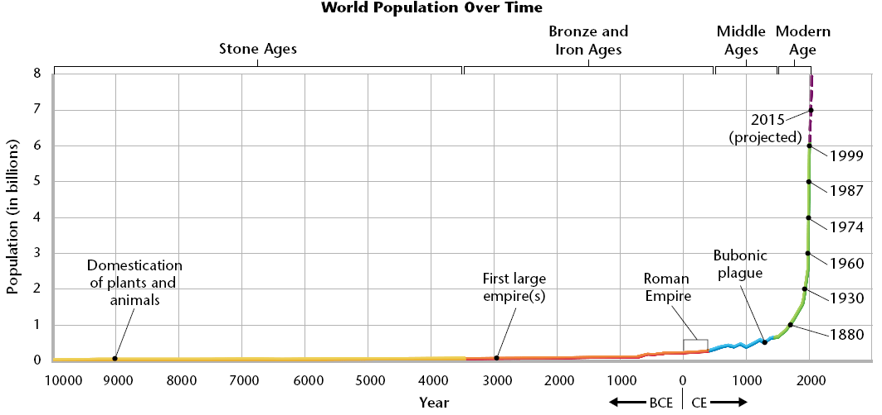
World Population Over Time

Slide 8
Age Structure
Age structure is the classification of members of a population into groups according to age or the distribution of members of a population in terms of age groups and helps demographers make predictions.
Countries that have high rates of growth usually have more young people than older people.
In contrast, countries that have slow growth or no growth usually have an even distribution of ages in the population.

Slide 9
Age Structure
Age structure can be graphed in a population pyramid, a type of double sided bar graph.
The figure on the following slide shows typical age structures for countries that have different rates of growth.

Slide 10
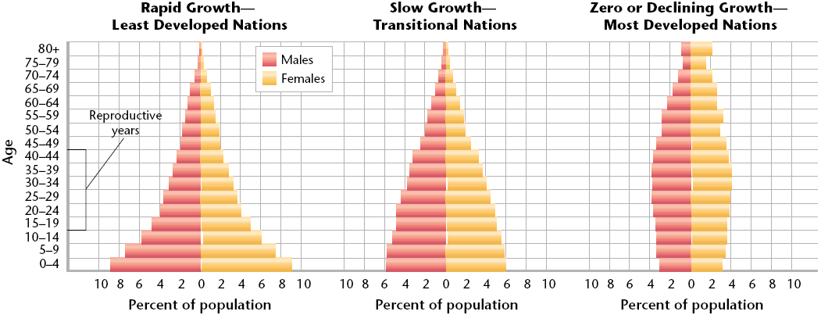
Age-Structure Diagrams

Slide 11
Survivorship
Survivorship is the percentage of newborn individuals in a population that can be expected to survive to a given age.
It is used as another way to predict population trends.
To predict survivorship, demographers study a group of people born at the same time and notes when each member of the group dies.

Slide 12
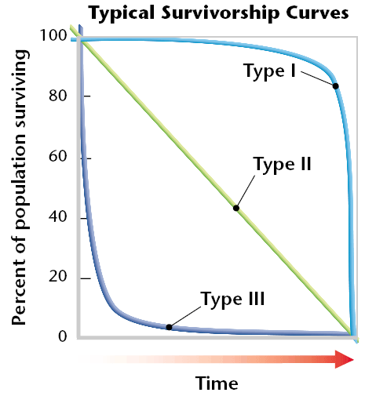
Survivorship
The results of these studies are then plotted on a graph and might look like one of the types of survivorship graphs below.

Slide 13
Survivorship
Wealthy developed countries such as Japan and Germany currently have a Type I survivorship curve because most people live to be very old.
Type II populations have a similar death rate at all ages.
Type III survivorship is the pattern in very poor human populations in which many children die.
Both Type I and Type III may result in populations that remain the same size or grow slowly.

Slide 14
Fertility Rates
A fertility rate is the number of births (usually per year) per 1,000 women of childbearing age (usually 15 to 44).
Replacement level is the average number of children each parent must have in order to “replace” themselves. This number is slightly more than 2 because not all children born will survive and reproduce.

Slide 15
Fertility Rates
A graph of historical fertility rates for the United States is shown on the next slide.
In 1972, the total fertility dropped below replacement level for the first time in US History.
Fertility rates remained below replacement level for most of the 1990s, but recently has been growing partly because the children of the baby boom grew up and had children.

Slide 16
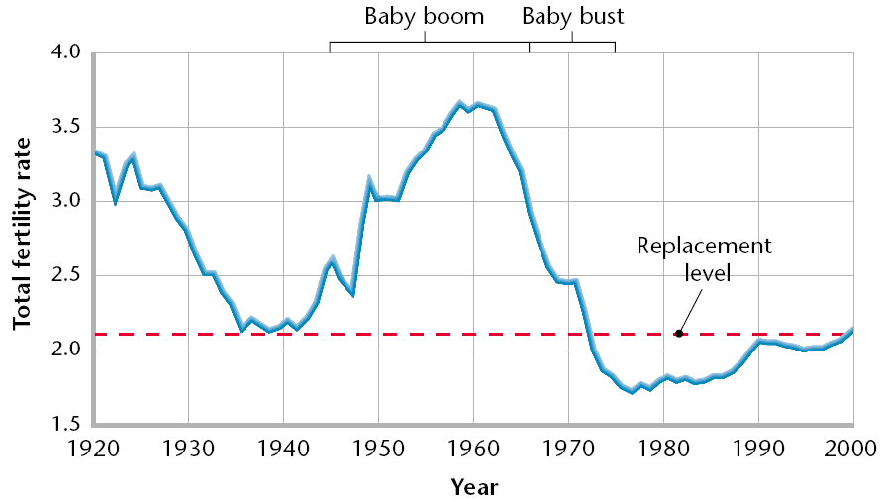
Fertility Rates

Slide 17
Migration
Migration in general, is any movement of individuals or populations from one location to another.
Movement into an area is immigration and movement out of an area is emigration.
The populations of many developed countries might be decreasing if not for immigration.

Slide 18
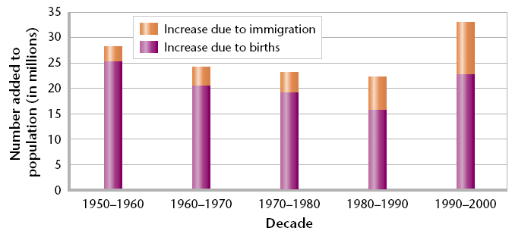
Migration
Migration between and within countries is a significant part of population change.

Slide 19
Declining Death Rates
The dramatic increase in Earth’s human population in the last 200 years has happened because death rates have declined more rapidly than birth rates.
Death rates have declined mainly because more people now have access to adequate food, clean water, and safe sewage disposal.
The discovery of vaccines in the 20th century also contributed to the declining death rates.

Slide 20
Life Expectancy
Life expectancy is the average length of time that an individual is expected to live.
Life expectancy is most affected by infant mortality, the death rate of infants less than a year old.
Expensive medical care is not needed to prevent infant deaths. Infant health is more affected by the parents’ access to education, food, fuel, and clean water.

Slide 21
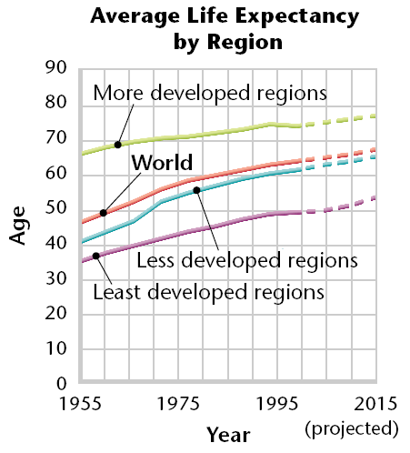
Life Expectancy
The graph shows that average life expectancy worldwide has increased to more than 67 years old. But, new threats, such as tuberculosis and AIDS are arising as populations become denser.

Slide 22
The Demographic Transition
The demographic transition is the general pattern of demographic change from high birth and death rates to low birth and death rates, and observed in the history of more-developed countries.
The theory behind the demographic transition is that industrial development causes economic and social progress that then affects population growth rates.

Slide 23
Stages of the Transition
In the first stage of the demographic transition, a society is in a preindustrial condition. The birth rate and the death rate are both at high levels and the population size is stable.
In the second stage, a population explosion occurs. Death rates decline as hygiene, nutrition, and education improve. But, birth rates remain high, so the population grows very fast.

Slide 24
Stages of the Transition
In the third stage, population growth slows because birth rate decreases. As the birth rate becomes close to the death rate, the population size stabilizes. However, the population is much larger than before the demographic transition.
In the fourth stage, the birth rate drops below replacement level, so the size of the population begins to decrease.
It has taken from one to three generations for the demographic transition to occur.

Slide 25
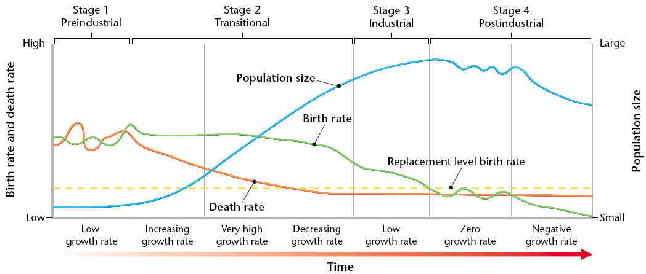
Stages of the Transition

Slide 26
Women and Fertility
The factors most clearly related to a decline in birth rates are increasing education and economic independence for women.
In the demographic transition model, the lower death rate of the second stage is usually the result of increased levels of education.
Educated women find that they do not need to bear as many children to ensure that some will survive. They may also learn family planning techniques.

Slide 27
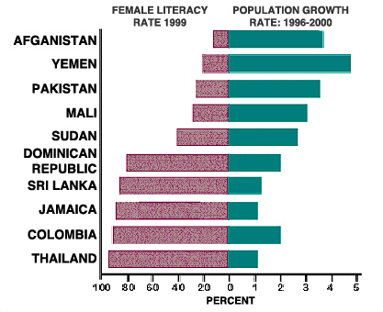

Slide 28
Women and Fertility
Women are able to contribute to their family’s increasing prosperity while spending less energy bearing and caring for children.
As countries modernize, parents are more likely to work away from home. If parents must pay for child care, children may become a financial burden rather than an asset.
All of these reasons contribute to lower birth rates in both developed and developing countries.

Slide 29
Changing Population Trends
Throughout history, and currently in many parts of the world, populations that have high rates of growth create environmental problems.
A rapidly growing population uses resources at an increased rate and can overwhelm the infrastructure of a community.
Infrastructure is the basic facilities of a country or region, such as roads, bridges, sewers, power plants, subways, schools, and hospitals.

Slide 31
Problems of Rapid Growth
A rapidly growing population can use resources faster than the environment can renew them, unless resources come from elsewhere.
Standards of living decline when wood is removed from local forests faster that it can grow back, or when wastes overwhelm local water sources.
Symptoms of overwhelming populations include suburban sprawl, polluted rivers, barren land, inadequate housing, and overcrowded schools.

Slide 32
A Shortage of Fuelwood
In many of the poorest countries, wood is the main fuel source.
When populations are stable, people use fallen tree limbs for fuel. When populations grow rapidly, deadwood does not accumulate fast enough to provide enough fuel.
People then begin cutting down living trees, which reduces the amount of wood available in each new year.

Slide 33
A Shortage of Fuelwood
A supply of fuel ensures that a person can boil water and cook food.
In many parts of the world, water taken directly from wells is not safe to drink. Food is often unsafe to eat unless it is cooked.
Water can be sterilized, and food can be cooked, but fuel is need to do so. Without enough fuelwood, many people suffer from disease and malnutrition.

Slide 34
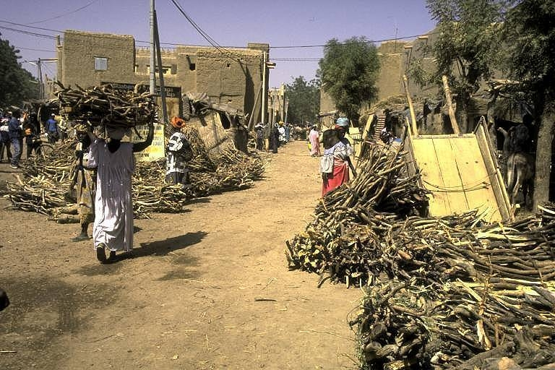

Slide 35
Unsafe Water
In places that lack infrastructure, the local water supply may be used not only for drinking and washing but also for sewage disposal.
As a result, the water supply becomes a breeding ground for organisms that can cause diseases such as dysentery, typhoid, and cholera.
Many cities have populations that are doubling every 15 years, and water systems cannot be expanded fast enough to keep up with this growth.

Slide 37
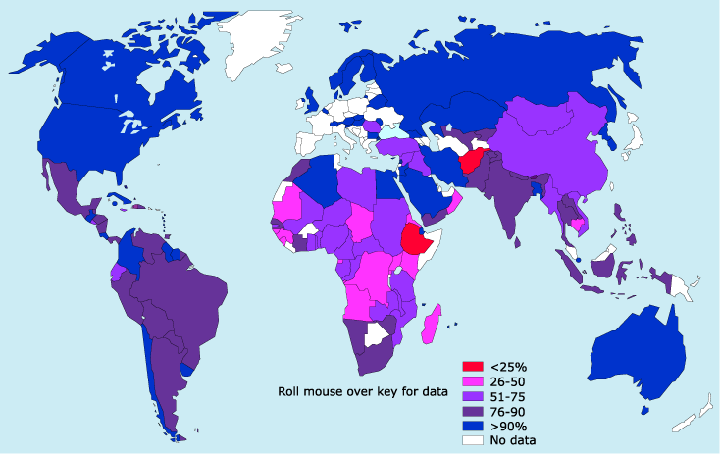

Slide 38
Impacts on Land
Growing populations may have a shortage of arable land.
Arable land is farmland that can be used to grow crops.
Growing populations also make trade-offs between competing uses for land such as agriculture, housing, or natural habitats.

Slide 39
Impacts on Land
For example, Egypt has a population of more than 69 million that depends on farming within the narrow Nile River valley.
Most of the country is desert, and less than 4 percent of Egypt’s land is arable.
The Nile River Valley is also where the jobs are located, and where most Egyptians live. They continue to build housing on what was once farmland, which reduces Egypt’s available arable land.

Slide 40
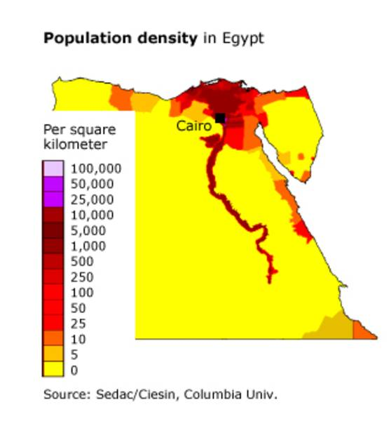

Slide 41
Impacts on Land
Urbanization is an increase in the ratio or density of people living in urban areas rather than in rural areas.
People often find work in the cities but move into suburban areas around the cities.
This suburban sprawl leads to traffic jams, inadequate infrastructure, and reduction of land for farms, ranches, and wildlife habitat. Meanwhile, housing within cities becomes more costly, more dense, and in shorter supply.

Slide 43
A Demographically Diverse World
Not every country in the world is progressing through each stage of demographic transition.
Some countries now have modern industries, but incomes remain low. A few countries have achieved stable and educated populations with little industrialization.
Some countries seem to remain in the second stage and are unable to make enough educational and economic gains to reduce birth rates and move into the third stage.

Slide 44
A Demographically Diverse World
In recent years, the international community has begun to focus on the least developed countries.
Least developed countries are countries that have been identified by the united Nations as showing the fewest signs of development in terms of income, human resources, and economic diversity.
These countries may be given priority for foreign aid and development programs to address their population and environmental problems.

Slide 45
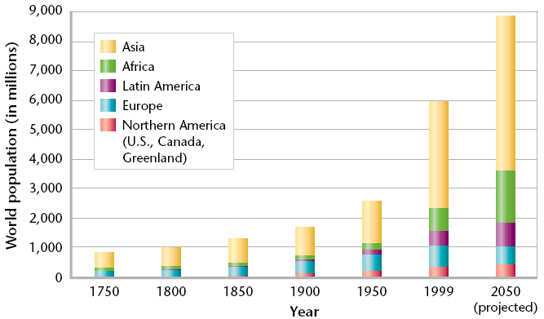
A Demographically Diverse World
Populations are still growing rapidly in less developed countries, with most of the world’s population now within Asia.

Slide 46
Managing Development and Population Growth
Today, less developed countries face the likelihood that continued population growth will prevent them from imitating the development of the world’s economic leaders.
Countries such as China, Thailand, and India have created campaigns to reduce the fertility rates of their citizens.
These campaigns include public advertising, family planning programs, economic incentives, or legal punishment.

Slide 47
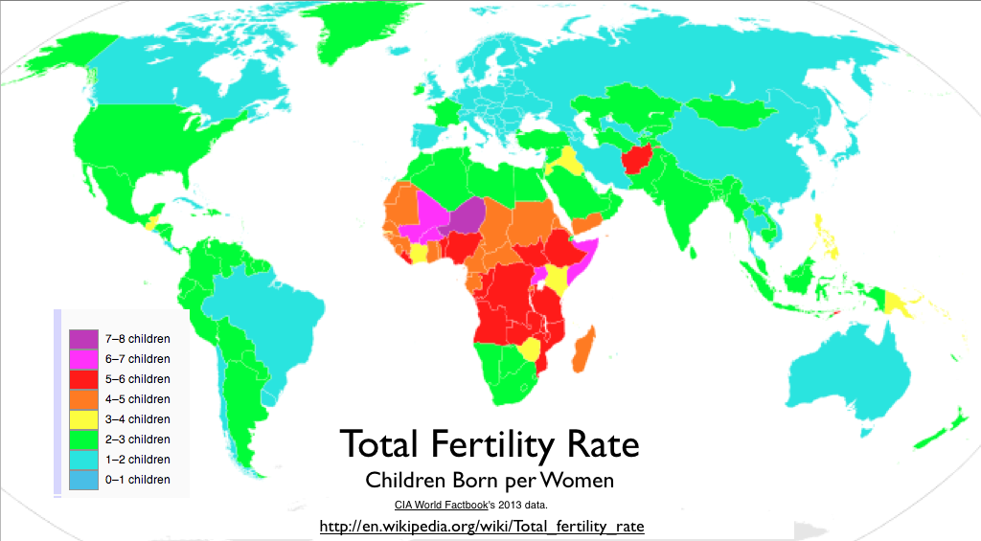

Slide 48
Managing Development and Population Growth
In 1994, the United Nations held the International Conference on Population and Development (ICPD),
It involved debates about the relationships between population, development, and the environment.
Many countries favor stabilizing population growth through investments in development, especially through improvements in women’s status.

Slide 49
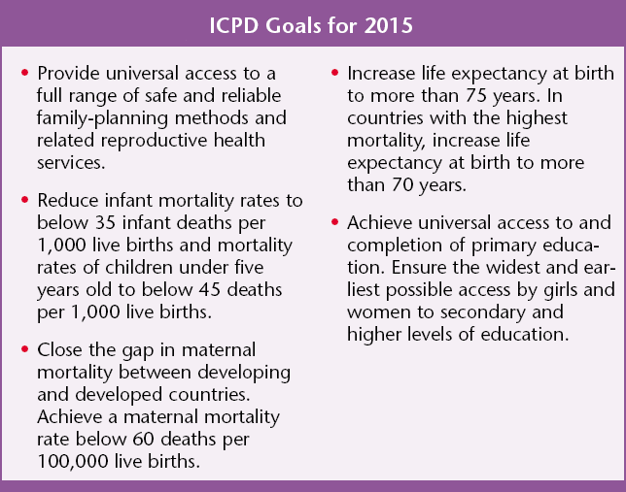
ICPD Goals for 2015

Slide 50
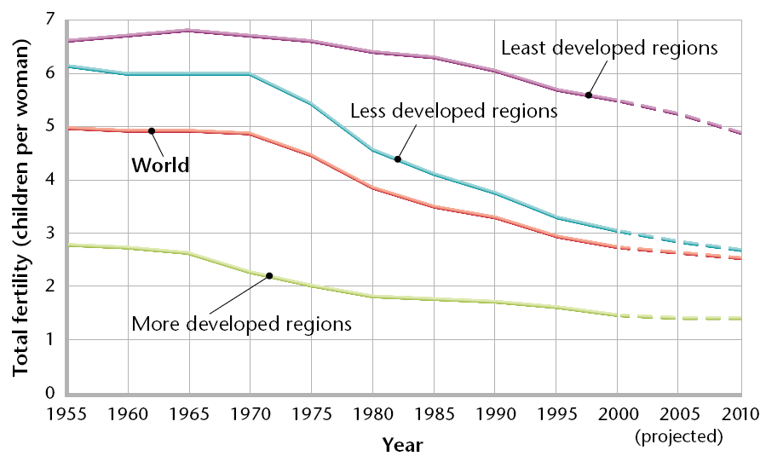
Managing Development and Population
With these goals, worldwide fertility rates are dropping as shown below.

Slide 51
Growth Is Slowing
Fertility rates have declined in both more-developed and less-developed regions.
Demographers predict that this trend will continue and that worldwide population growth will be slower this century than the last century.
If current trends continue, most countries will have replacement level fertility rates by 2050. If so, world population growth would eventually stop.

Slide 52
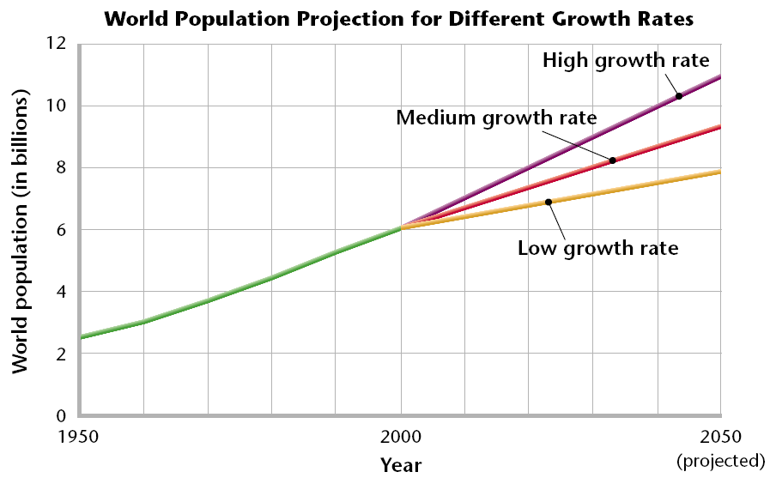
Projections to 2050
Looking at the graph below, most demographers predict the medium growth rate, and a world population of 9 billion in 2050.

