Slide 1
Chapter 20: The Environment and Human Health

Slide 2
Environmental Effects on Health
The World Health Organization (WHO) has begun to collect data on how the environment affects human health
People in developing countries suffer greater health impacts
Poor sanitation= disease

Slide 3
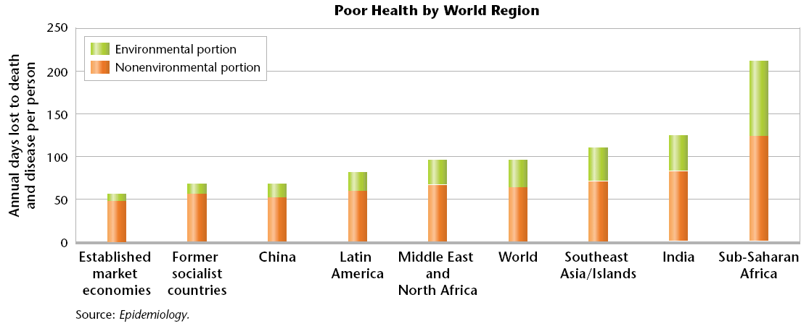
Environmental Effects on Health

Slide 4
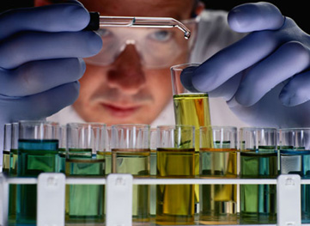
Toxicity: How Dangerous Is It?
Toxicology is the study of toxic substances, including their nature, effects, detection, methods of treatment, and exposure control

Slide 5
Toxicity: How Dangerous Is It?
The toxic effect of a chemical depends on:
Dose
Exposure
Body size
Body’s ability to break down the chemicals

Slide 6
Toxicity: How Dangerous Is It?
A persistent chemical is a chemical that breaks down slowly in the environment.
People are more likely to come into contact with persistent chemicals, like DDT.

Slide 7
Dose-Response Curves
A dose-response curve is a graph that shows the relative effect of various doses of a drug or chemical on an organism or organisms
Sometimes, there is a threshold dose

Slide 8
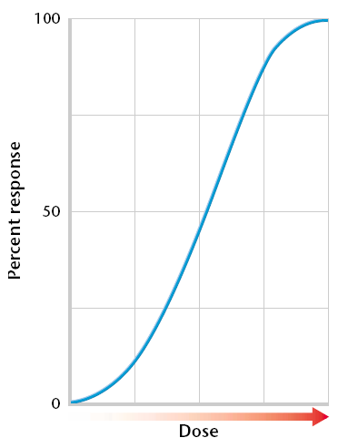
Dose-Response Curve

Slide 9
Epidemiology
Epidemiology is the study of the distribution of diseases in populations and the study of factors that influence the occurrence and spread of disease

Slide 10
Risk Assessment
Risk assessment is the scientific assessment, study, and management of risk. It is also the scientific estimation of the likelihood of negative effects that may result from exposure to a specific hazard

Slide 11
Risk Assessment
The process of risk assessment includes:
compiling and evaluating existing information on the substance,
determining how people might be exposed to it by using diagrams, air flow models, and others,
determining the toxicity of the substance,
and characterizing the risk of that substance to the public.

Slide 12
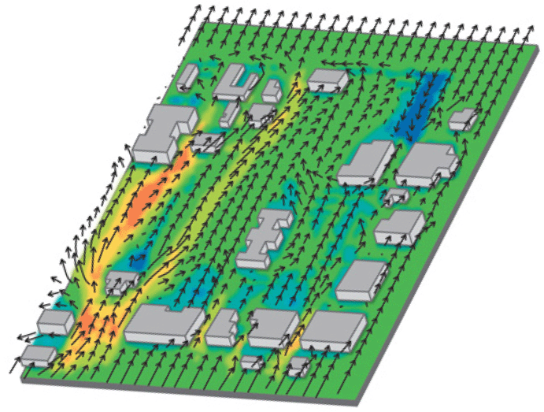
Risk Assessment
Air flow models like this one help scientists predict the path that air pollutants may follow through a city. The bright orange areas are receiving the most pollutants

Slide 13
Pollution from Natural Sources
The most common pollutants from natural sources are dust, soot, and other particulates.
Particulates are fine particles that are suspended in the atmosphere and that are associated with air pollution.
Dust storms, wildfires, volcanic eruptions all produce large amounts of particulates.

Slide 14
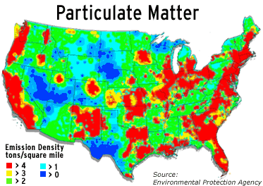

Slide 15
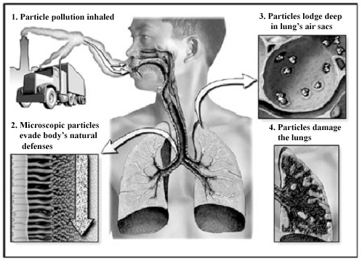

Slide 16
Heavy Metals
Another pollutant from natural sources are the so-called heavy metals
Dangerous heavy metals include the elements arsenic, cadmium, lead, and mercury
These elements occur naturally in rocks and soil
Most of these elements cause nerve damage when they are ingested beyond their threshold dose

Slide 17
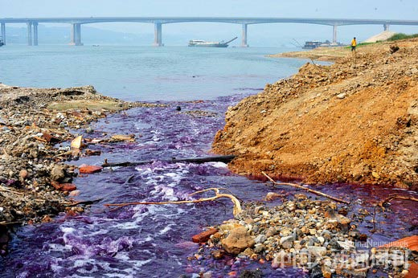

Slide 18
Recent Improvements
Scientists now think that chemical pollution may be part of the cause of Parkinson’s and Alzheimer’s diseases

Slide 19
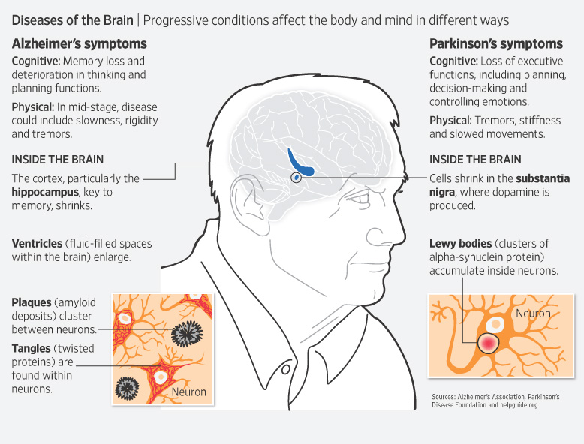

Slide 20
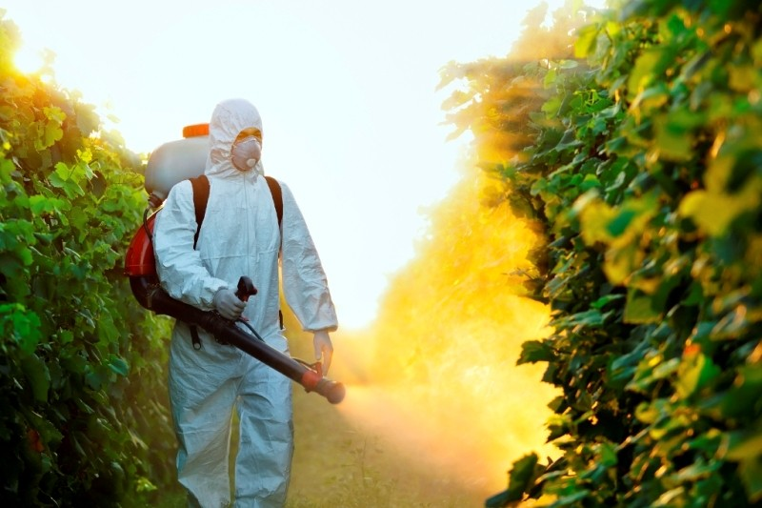
Pesticides
Pesticides are chemicals designed to kill unwanted organisms such as insects, fungi, or weeds

Slide 21
Industrial Chemicals
Older building were often painted using lead-based paint. Lead is directly linked to brain damage and learning disabilities

Slide 22
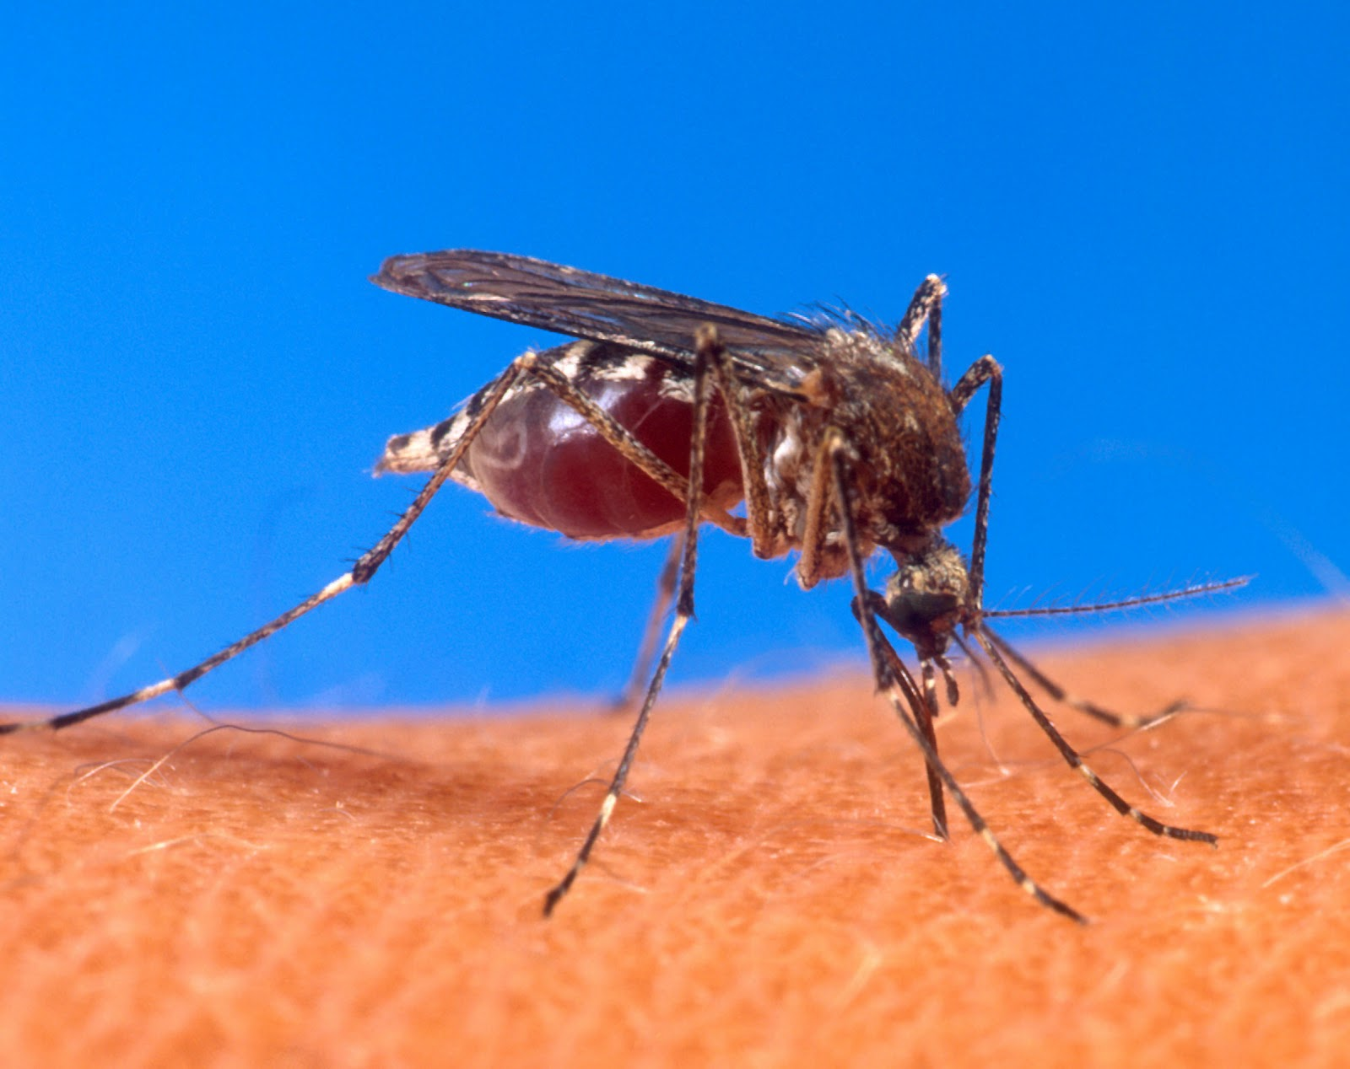
The Environment’s Role in Disease
Infectious diseases are caused by pathogens, a virus, microorganism, or other substance that causes disease
Pathogens spread by contact, air, water, or food.
A host an organism from which a parasite takes food and shelter

Slide 23
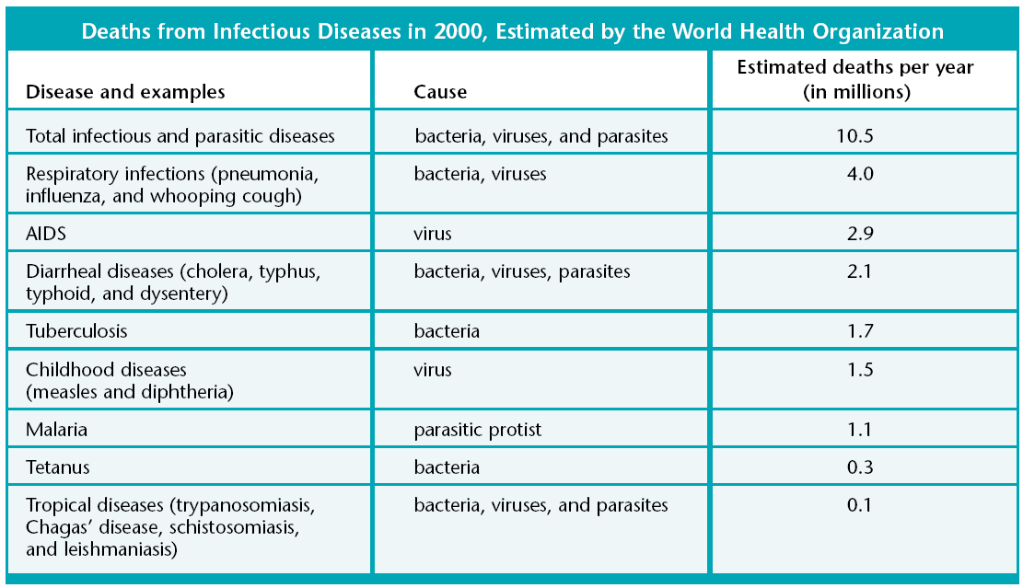
The Environment’s Role in Disease

Slide 24
Cholera
Nearly three-fourths of infectious disease are transmitted through water
Cholera
Dysentery

Slide 25
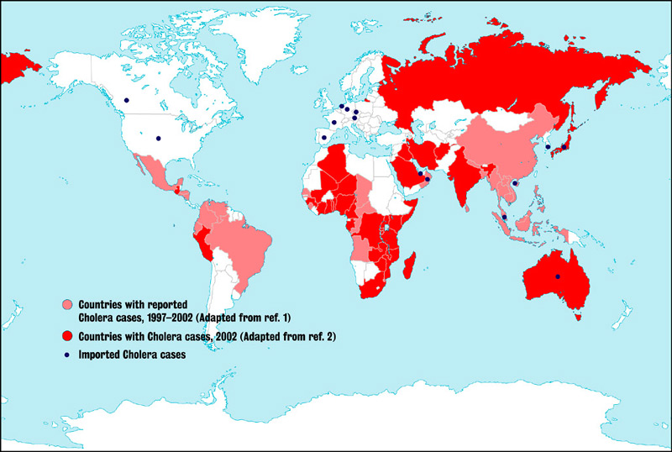

Slide 26
Antibiotic Resistance
By altering the environment, we make it more suitable for pathogens to live and reproduce
In 1979, 6% of European strains of pneumonia bacteria were resistant to antibiotics. Ten years later, 44% of the strains were resistant

Slide 28
Malaria
Malaria was once the world’s leading cause of death
Malaria is caused by parasitic protists and is transmitted by a bite from female mosquitoes of many species
No effective vaccine for malaria exists, but preventative measures are used to control mosquitoes

Slide 29
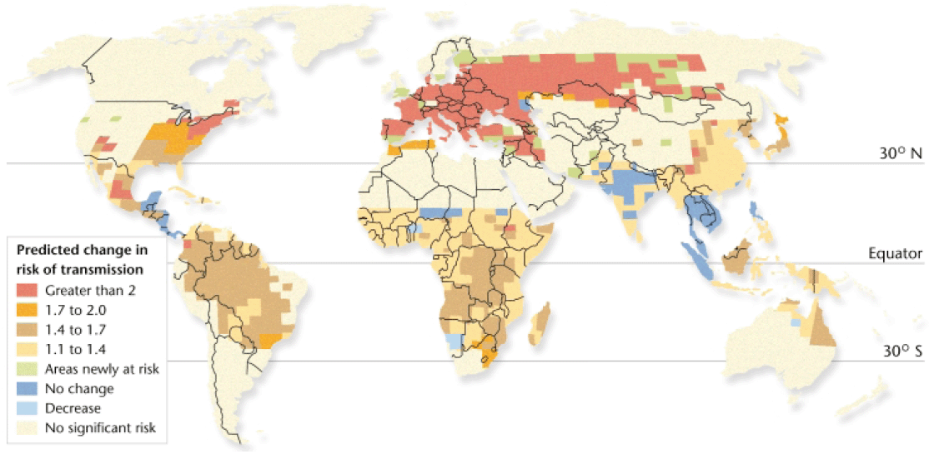
Malaria on the March

Slide 30
Emerging Viruses
Hanta
Zika
Ebola

Slide 31
Emerging Viruses
We do not have many effective drugs to treat viral diseases.
Our main defense against viral diseases is vaccination.
However, vaccines are virus specific and viruses evolve rapidly.
New vaccines must be developed when a new strain of a viral pathogen evolves.

Slide 32
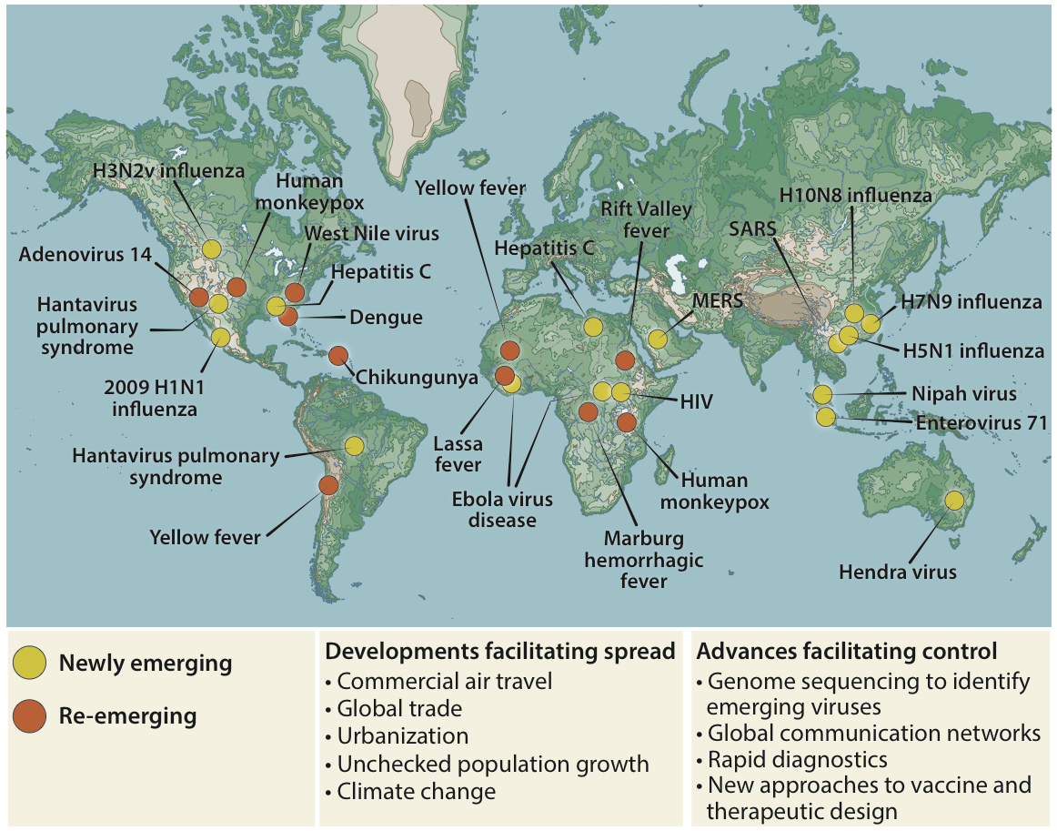

Slide 33
Cross-Species Transfer
Cross-species transfer pathogens that have moved from one species to another

