Slide 1
8.8.17
Opener: What is the Scientific Method?
TURN IN to the front:
signed safety contracts
Signed Syllabus
Get to know you WS
Safety Poster

Slide 2
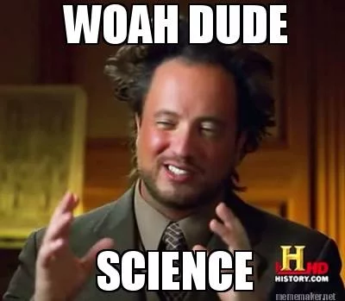
What is Science?
The goal of science is to investigate and understand the natural world, to explain events in the natural world, and to use those explanations to make useful predictions.
In other words, science is an organized way of using evidence to learn about the natural world. Over time scientists build up a large body of knowledge.

Slide 3
EQ: What is the Scientific Method

Slide 4
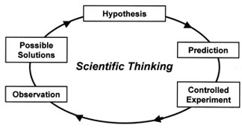
Scientific Method
The scientific method is the process scientist use to determine the truth. There are four steps.

Slide 5
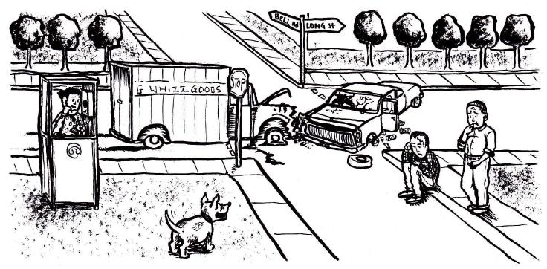
1. Observation
Scientific Thinking usually begins with observations.
Making an observation or seeing a problem. Based on this you may make an inference about your observation
inference : a logical interpretation based on prior knowledge or experience.

Slide 6
Inference
inference : a logical interpretation based on prior knowledge or experience.

Slide 7
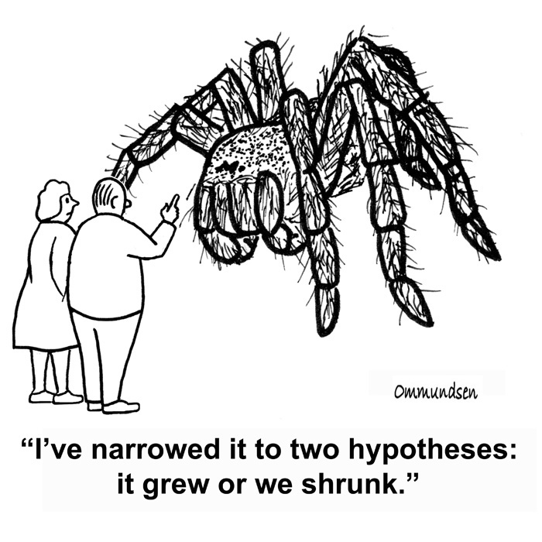
2. Hypothesis
A testable, possible solution. Your inference may lead to your hypothesis.

Slide 8
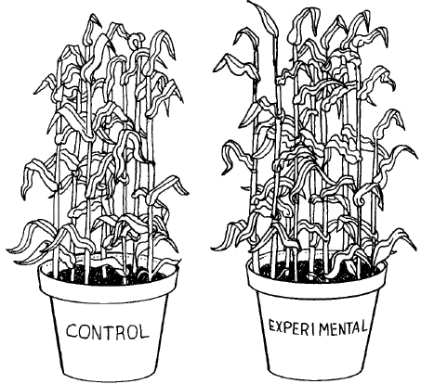
3. Experiment-
A controlled method of testing a question. Only ONE variable is changed at a time. All other Variables should be kept unchanged.

Slide 9
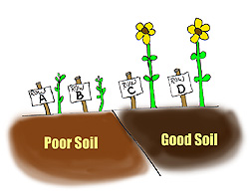
4. Conclusion:
Was your hypothesis correct? Does it lead to further inquiry?

Slide 10
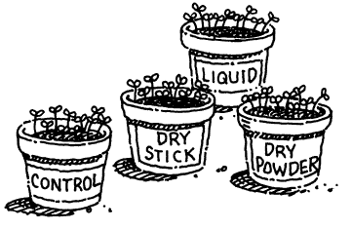
Independent Variable
Manipulated variable that is deliberately changed

Slide 11
Dependant Variable
Responding variable that is observed IN RESPONSE to the Independent variable

Slide 12
Control
The experimental component in which no variables are applied. Used as a source of comparison.

Slide 13
Constants
Experimental components which must remain the same. They show if the experimental variable affected the outcome

Slide 14
Video clip
Mythbusters (plants and music)
Spongebob WS

Slide 15
For each item below, specify the independent and dependent variables, as well as constants.
1. A study was done to find if different tire treads affect the braking distance of a car.
I: D: C:
2. The time it takes to run a mile depends on the person’s running speed.
I: D: C:
3. The height of bean plants depends on the amount of water they receive.
I: D: C:
4. The higher the temperature of the air in the oven, the faster a cake will bake.
I: D: C:
5. Lemon trees receiving the most water produced the most lemons.
I: D: C:
6. An investigation found that more bushels of potatoes were produced when the soil was fertilized more.
I: D: C:

Slide 16
For each item below, specify the independent and dependent variables, as well as constants.
1. A study was done to find if different tire treads affect the braking distance of a car.
I: Different tire treads D: Braking distance C: type of car, road conditions, time of day…..
2. The time it takes to run a mile depends on the person’s running speed.
I:running speed D: time C: stide, male female, what they ate……
3. The height of bean plants depends on the amount of water they receive.
I:amount of H2oD: hightC: sun, soil, ……
4. The higher the temperature of the air in the oven, the faster a cake will bake.
I: Temperature D: how fast bake C: type of cake, ingredients, pan, sea leval
5. Lemon trees receiving the most water produced the most lemons.
I: amnt of water D: how many lemons C: soil type, location…..
6. An investigation found that more bushels of potatoes were produced when the soil was fertilized more.
I: amt of fertilizer D: # potatoes C: _________________

Slide 17
Environmental Sciences
Grab your paper from the walk last Friday
Complete activity part 2
You will be turning this in for a grade. (write in complete sentences!)

Slide 18
TOTD:
Paul and Suzi want to conduct an experiment with water balloons. The water balloons will be the same size, shape, and type. They want to test whether or not the water balloons will pop faster if they stand further apart when they through the balloons. To start with, they are going to stand 10 feet apart and complete this task with 3 balloons, recording when each balloon pops. For the next 2 trials, they are going to stand 20 feet apart and do the same thing.
What is the Dependent and Independent Variable? Control? Constant?

