Slide 1
Key questions
1. How do scientists classify animals?
2. What is binomial nomenclature?
3. What are cladograms?
4. How do I use a dichotomous key?

Slide 2
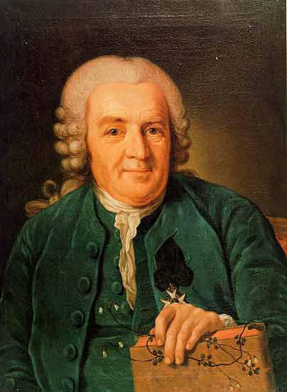
I. Taxonomy: the study of classifying organisms
A. Taxonomists are scientist who study classifying
B. Taxon (taxa-plural) is a category into which related organism are placed
Carolus Linnaes: father of the modern day naming system

Slide 3
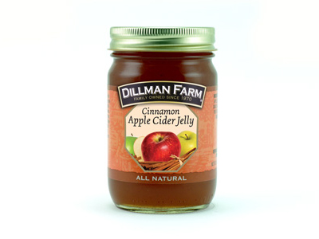
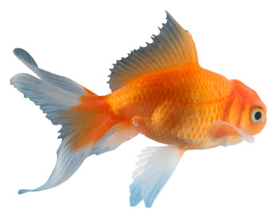
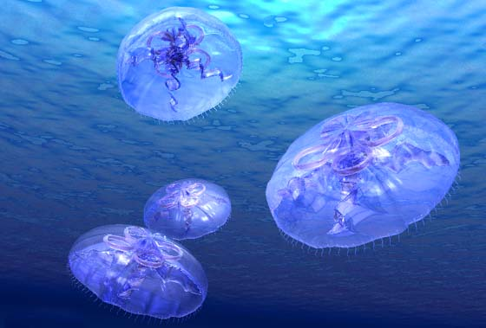
II. Reasons to Classify:
A. Shows evolutionary relationships
B. Accurately and uniformly names organisms
C. Prevents misnomers such as starfish and jellyfish that aren’t really fish

Slide 4
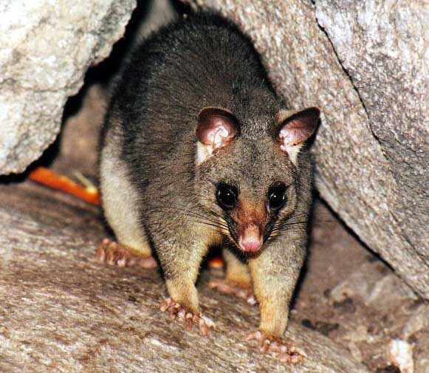
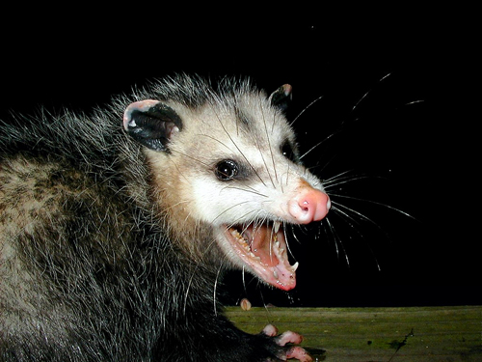
D. Uses the same language (Latin) for all names
E. Prevents duplicated names because all names must be approved by International Naming Congresses
Australian Possum
American Possum

Slide 5
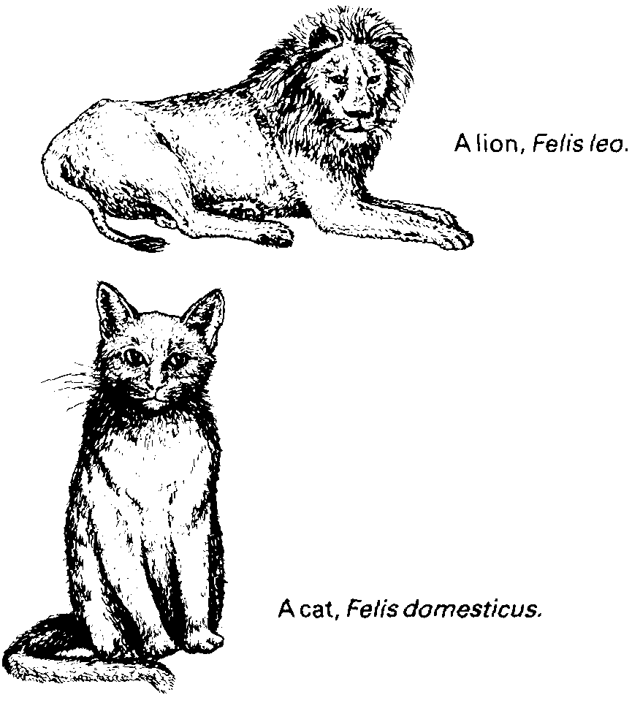
IV. Binomial Nomenclature
A. The modern system of naming, binomial nomenclature, uses a two word name (Genus and Species)
B. Scientific names should be italicized in print or underlined when writing

Slide 6
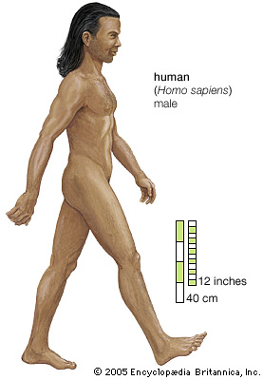
C. Always capitalize the genus name, but write the species in lower case (ex: Homo sapiens)
D. The genus name may be abbreviated, but not the species (ex: H. sapiens)

Slide 7
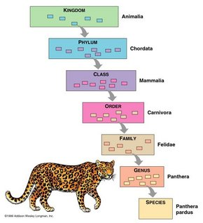
V. Taxonomic Categories
Kingdom
Phylum
Class
Order
Family
Genus
Species

Slide 8
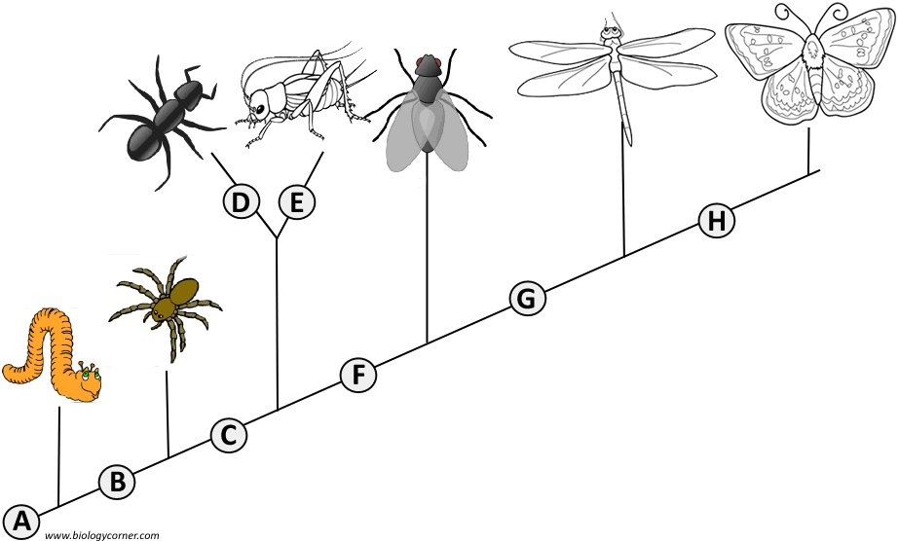
Cladograms show how organisms are related based on shared characteristics
1. ______ Wings
2. ______ 6 Legs
3. ______ Segmented Body
4. ______ Double set of wings
5. ______ Jumping Legs
6. ______ Crushing mouthparts
7. ______ Legs
8. ______ Curly Antennae

Slide 9
VII. Dichotomous Key
A. A tool used to identify organisms
B. A series of pared statements that describe physical characteristics of different organisms.
Example:
Classify: the following

Slide 10
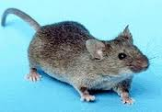

Slide 11
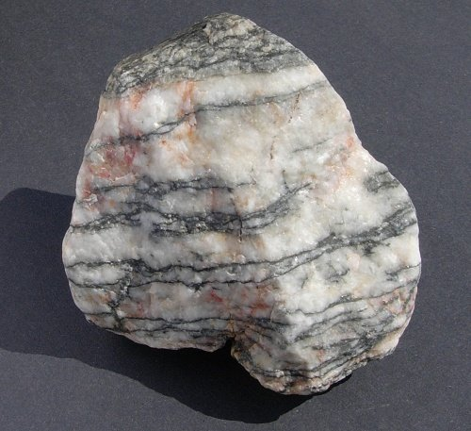

Slide 12
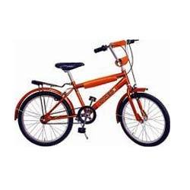

Slide 13
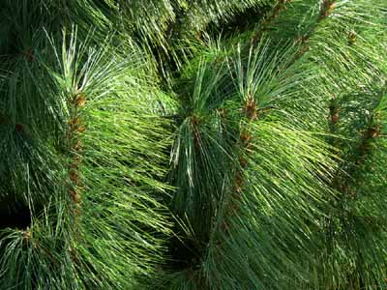

Slide 14
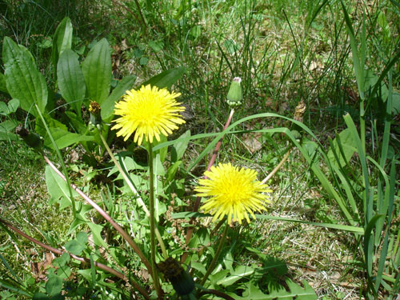

Slide 15
KINGDOMS OF LIFE

Slide 16
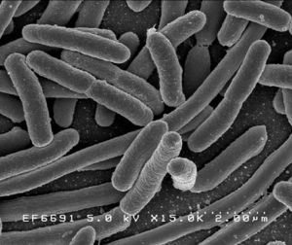
EUBACTERIA
DOMAIN = Bacteria
Eu = True meaning “True Bacteria”
Prokaryotes or Eukaryotes or Both?

Slide 17
EUBACTERIA
Cell Structures

Slide 18
EUBACTERIA
# of Cells? Unicellular or Multicellular?

Slide 19
EUBACTERIA
Mode of Nutrition: Autotroph, Heterotroph, or Both?

Slide 20
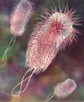
EUBACTERIA
Streptococcus
E. Coli

Slide 21
ARCHAEBACTERIA
Domain = Archaea
Prokaryote or Eukaryote?

Slide 22
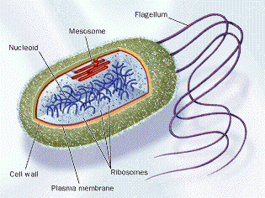
ARCHAEBACTERIA
Cell Structure

Slide 23
ARCHAEBACTERIA
Number of Cells: Unicellular or Multicellular or Both?

Slide 24
ARCHAEBACTERIA
Mode of Nutrition: Autotroph, Heterotroph, or Both?

Slide 25
ARCHAEBACTERIA
Examples: Live in EXTREME Conditions!

Slide 26
PROTISTA
DOMAIN = Eukarya
Prokaryote or Eukaryote?

Slide 27
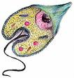
PROTISTA
Cell Structures
Cell walls are made
of?
Some have
Chloroplasts

Slide 28
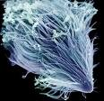
PROTISTA
Number of Cells: Unicellular or Multicellular or Both?

Slide 29
PROTISTA
Mode of Nutrition: Autotroph or Heterotroph or Both?

Slide 30
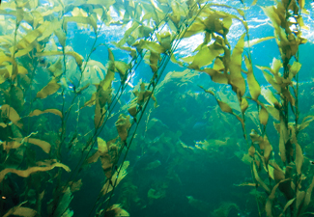
PROTISTA
Examples:
Slime Molds
Paramecium
Amoeba
Giant Kelp

Slide 31
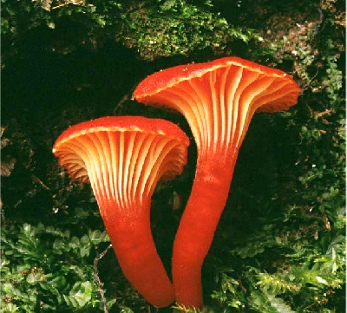
FUNGI
DOMAIN = Eukarya
Prokaryote or Eukaryote?

Slide 32
FUNGI
Cell Structures:
Cell walls made of?

Slide 33
FUNGI
Number of Cells: Unicellular or Multicellular or Both?
YEAST

Slide 34
FUNGI
Mode of Nutrition: Autotroph, Heterotroph, or Both?
Hint: Look at the roots!

Slide 35
FUNGI
Examples:
YEAST
MUSHROOMS

Slide 36
PLANTAE
DOMAIN = Eukarya
Eukaryote or Prokaryote?

Slide 37
PLANTAE
Cell Structures
Cell walls made of?
__________ Performs Photosynthesis

Slide 38
PLANTAE
Number of Cells: Multicellular, Unicellular, or Both?

Slide 39
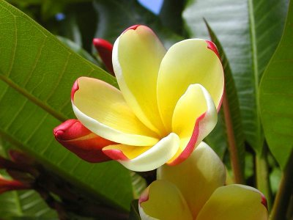
PLANTAE
Mode of Nutrition: Autotroph, Heterotroph or Both?

Slide 40
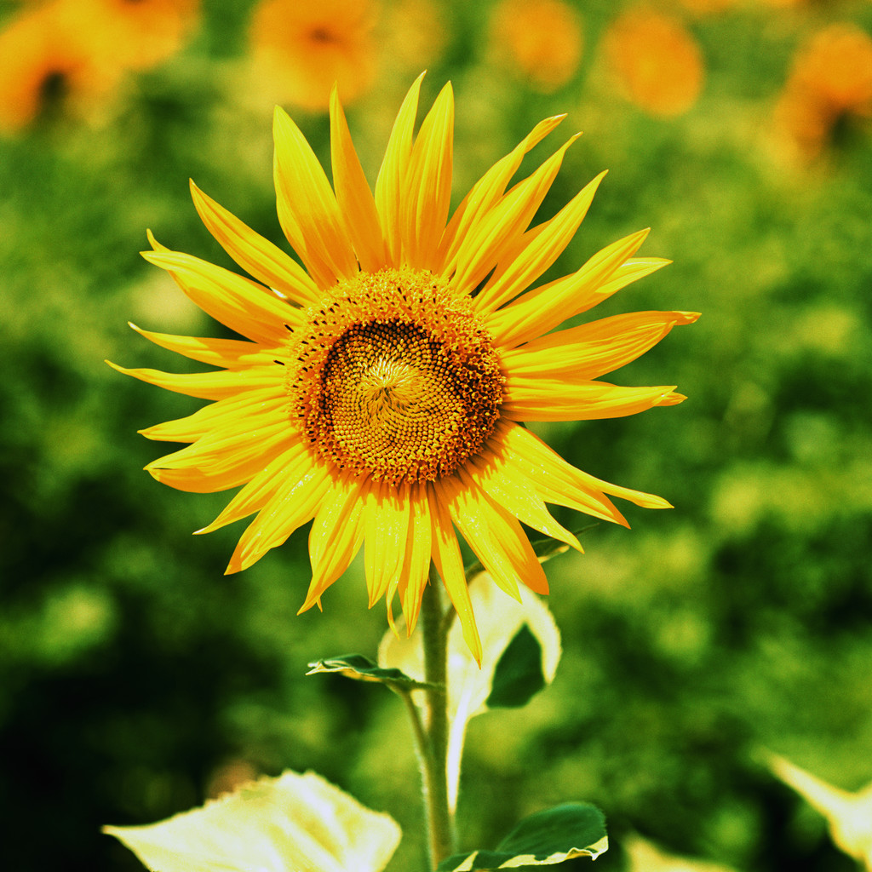
Examples
Examples:
Mosses
Ferns
Flowering Plants

Slide 41
ANIMALIA
DOMAIN = Eukarya
Prokaryote or Eukaryote?

Slide 42
ANIMALIA
Cell Structures:
Cell walls?
Chloroplasts?

Slide 43
ANIMALIA
Number of Cells: Unicellular or Multicellular?

Slide 44
ANIMALIA
Mode of Nutrition: Autotroph or Heterotroph?

Slide 45
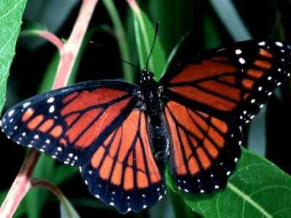
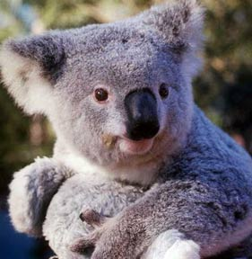
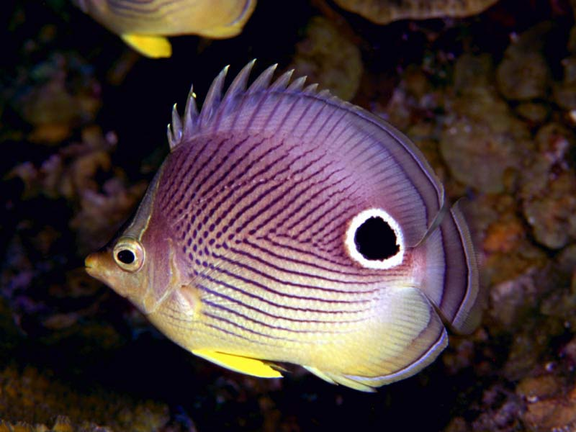
ANIMALIA
Examples:
Sponges
Insects
Mammals
Worms
Fishes

Slide 46
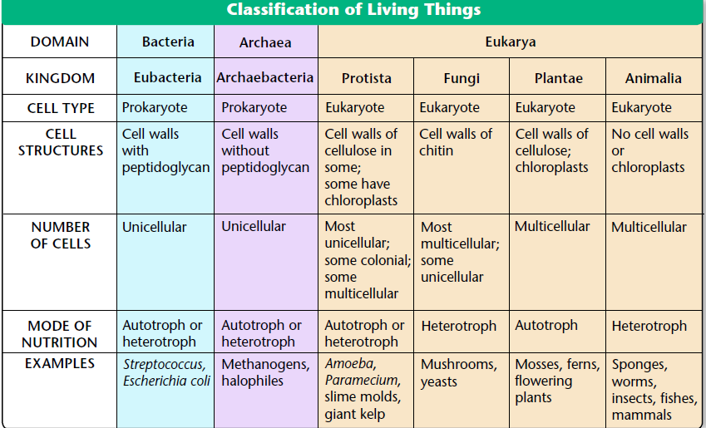

Slide 47
VIRUSES
WHERE ARE THEY CLASSIFIED?!?
Bacteriophage
Flu Virus

Slide 48
VIRUSES
Characteristic | Virus | Cell
Structure | DNA or RNA, core, capsid | Cell membrane, cytoplasm
Reproduction | Only in host cell | Cell division
Genetic Code | DNA or RNA | DNA
Growth/Development | No | Yes, multicellular organisms
Obtain/Use Energy | No | Yes
Response to Environment | No | Yes
Change over time | Yes | Yes

Slide 49
Viruses
REPRODUCTION: 2 Pathways
Lytic and Lysogenic
Khan academy video
Amoeba Sisters (virus)

