Slide 1
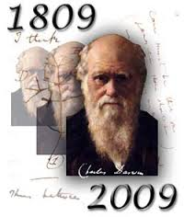
Speciation

Slide 2
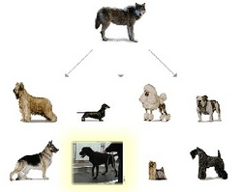
Darwin took an interest in breeding
Humans can breed animals for specific characteristics. Darwin called this process Artificial Selection
foxes

Slide 3
Gene pool
Gene Pool
Combined genetic information of a particular population.
All the genes present within a population can change

Slide 4
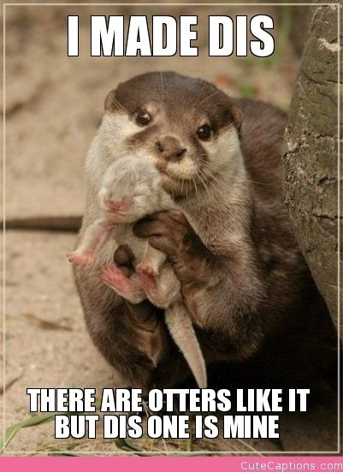
Speciation
The link between microevolution and macroevolution is speciation. It is the evolution of a new species
occurs when interbreeding happens, or when the production of fertile offspring is prevented
natural barriers form and cause the breakup of populations to form smaller populations
Examples: Volcanoes, sea-level changes, and earthquakes
A species is a group of organisms that can mate to produce fertile offspring.

Slide 5
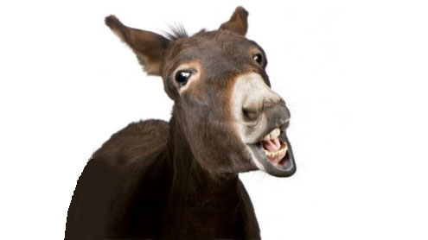
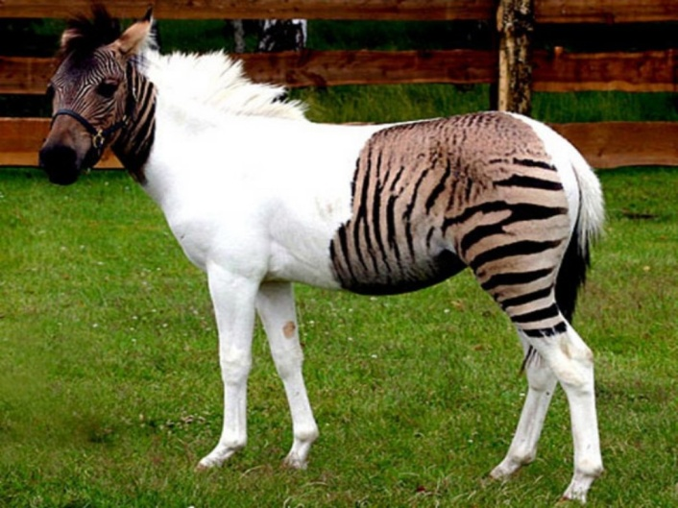
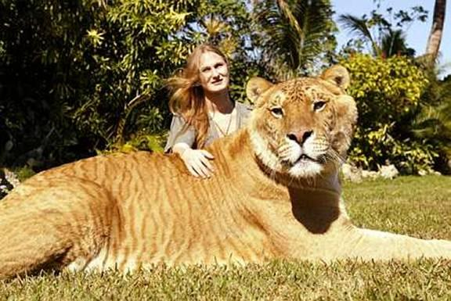
Hybrids
Some animals can mate but can not produce viable offspring: the offspring can not reproduce and produce offspring.

Slide 6
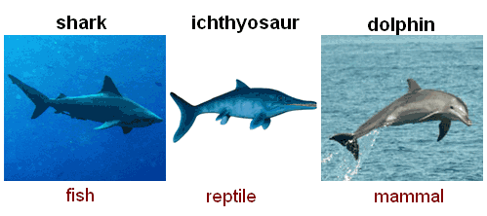
Convergent evolution
Species living in similar environments evolve similar adaptations

Slide 7
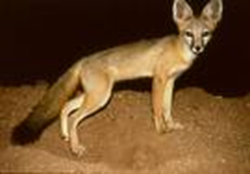
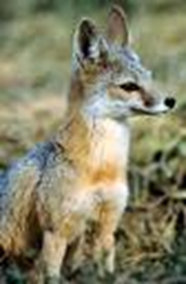
Divergent Evolution
Divergent evolution is the process of two or more related species becoming more and more dissimilar. Will eventually be unable to interbreed.
Ex:The red fox and the kit fox provide and example of two species that have undergone divergent evolution

Slide 8
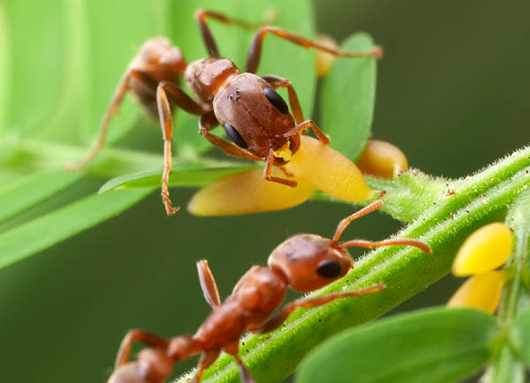
Coevoluiton
Organisms affect one another’s evolution

Slide 9
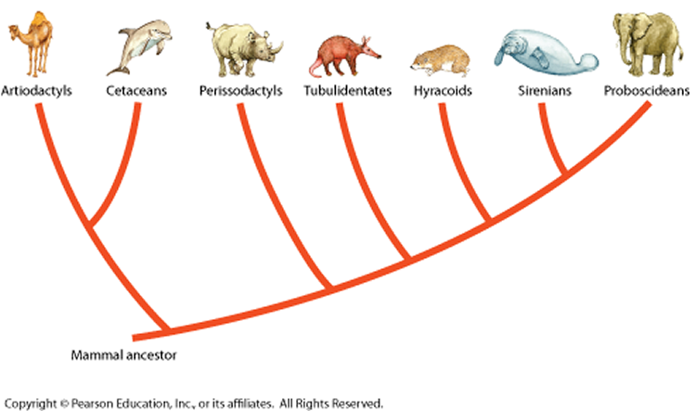
Adaptive radiation
Over time, species may split into two or more lines of descendants, or lineages. As the splitting repeats, one species can give rise to another species.

Slide 10
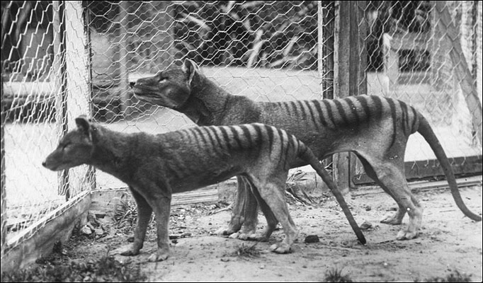
Extinction
All members of a lineage may die off or simply fail to reproduce. The fossil record show many lineages that have arisen, radiated but failed to survive.

