Slide 1
Mitosis & The Cell Cycle
Genetic Material
Interphase
Mitosis and Cytokinesis
Errors in Mitosis

Slide 2
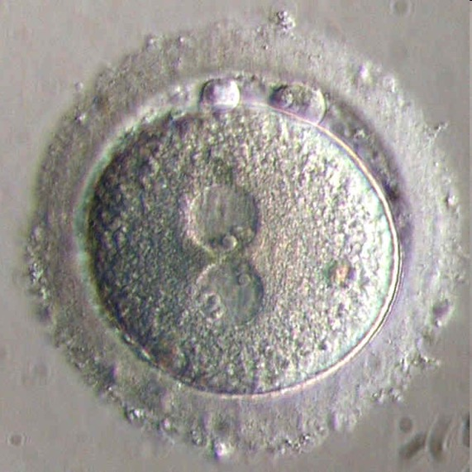
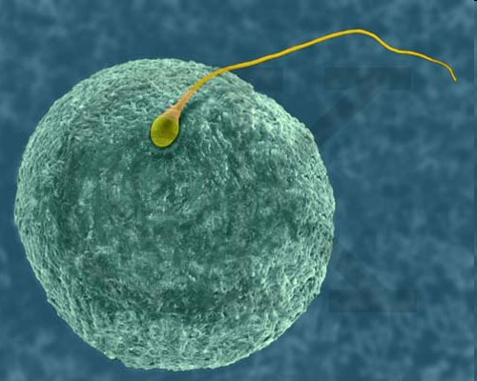
Fertilization is the start of life
Zygote
Egg and Sperm
A sperm cell and an egg cell come together to form a single cell called a Zygote

Slide 3
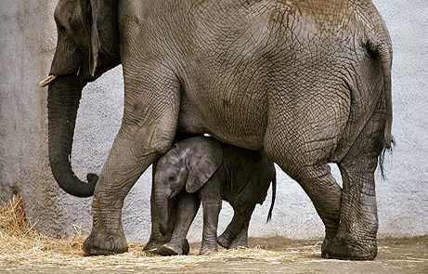
How do little elephants grow up to be BIG elephants?

Slide 4
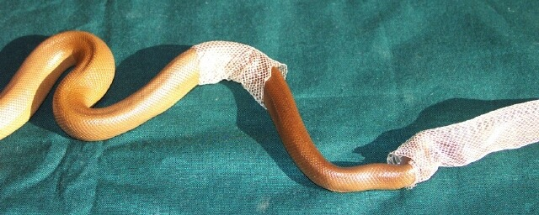
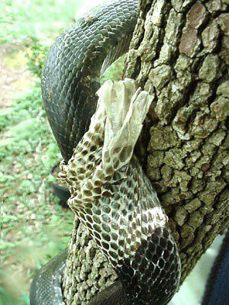
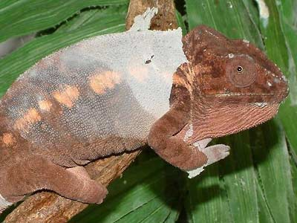
Why do animals shed their skin?

Slide 5
Because Of The Cell Cycle

Slide 6
Cell Cycle
Replication and division of the cells nucleus where the daughter cells are exact replications of the parent cells.
New body cells are produced for:
Growth
Replacing damaged or old cells

Slide 7
The Cell Cycle
Within The Cell Cycle there is the Growth Phase, Division Phase (Mitosis) and Cell Division (Cytokinesis)
The Growth phase is called Interphase
Division Phase (Mitosis) is comprised of:
Prophase
Metaphase
Anaphase
Telophase
Cell Division (Cytokinesis) causes 1 cell to become 2

Slide 8
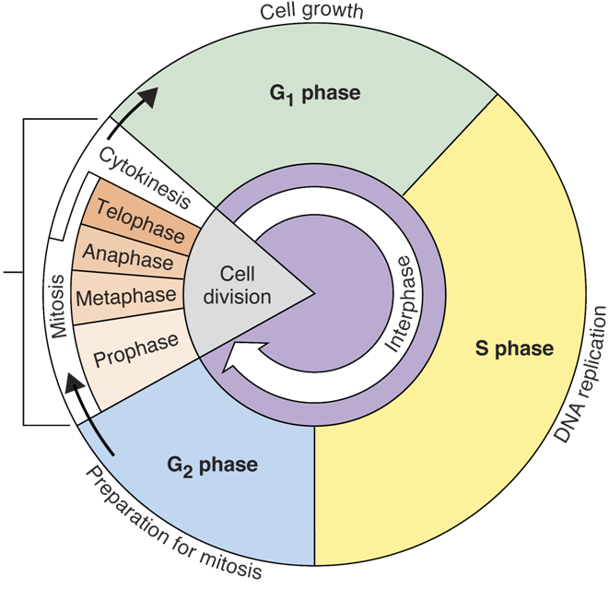
Mitosis and Cell Division
Interphase

Slide 9
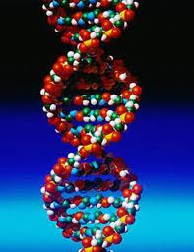
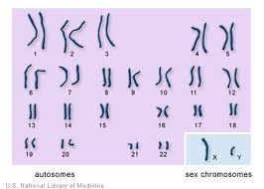
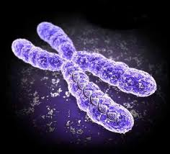
Genetic Material
DNA - Deoxyribonucleic acid
Chromosomes

Slide 10
Genetic Material
All of your genetic material is packaged into 46 chromosomes
23 chromosomes come from dad and 23 from mom
Chromosomes are composed of DNA which is the code that makes you who you are.

Slide 11
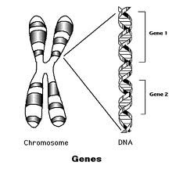
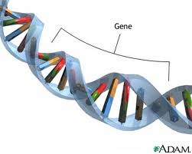
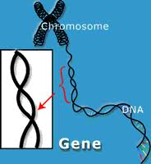
Genes
Chromosomes are made up of proteins and a code called DNA which is made of 4 compounds (A,T,G,C)
Chromosomes are divided into sections called genes

Slide 12
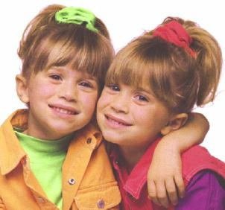
Genes
Genes are short sequences of DNA which tell the cell to make certain proteins
The proteins are what give us our individual characteristics
Each persons genes are different (except??)
Identical Twins

Slide 13
Genetic Features
Eye Colour

Slide 14
Genetic Features
Height

Slide 15
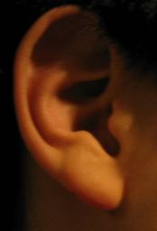
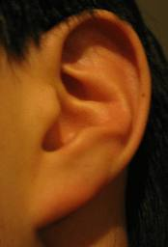
Genetic Features
Rolling Tongue
Earlobes

Slide 16
Human – Animal Gene Similarities
- Genome-wide variation from one human being to another can be up to 0.5% (99.5% similarity) - Chimpanzees are 96% to 98% similar to humans - Cats are 90% similar to humans, 82% with dogs, 80% with cows, 79% with chimpanzees, 69% with rats and 67% with mice - Cows are 80% genetically similar to humans - 75% of mouse genes have equivalents in humans - The fruit fly (Drosophila) shares about 60% of its DNA with humans - About 60% of chicken genes correspond to a similar human gene

Slide 17
End of Day 1

Slide 18
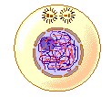
Interphase
• The time between cell divisions
• Cells undergoes DNA replication and growth
The cell spends most of its time in Interphase.

Slide 19
There are 3 Stages in Interphase:
G₁ Phase – cells carry out metabolic activities to prepare for the S Phase.
S Phase – “Synthesis Phase” – DNA is replicated.
G₂ Phase – organelles and molecules required for cell division are produced. Cell prepares for mitosis.

Slide 20
Interphase
Animal Cell
Plant Cell

Slide 21
Cell Division Phase (Mitosis)

Slide 22
Mitosis
Process whereby a cell will divide to produce two new identical cells
Allows organisms to grow and replace old, damaged or dead cells
Occurs in all body cells

Slide 23
Parent cell
Chromosomes are copied and double in number (Interphase)
Chromosomes now split
2 daughter cells identical to original
Every cell in your body contains the same genes, but only some act to make the cells specialised – e.g. nerve or muscle tissue.

Slide 24
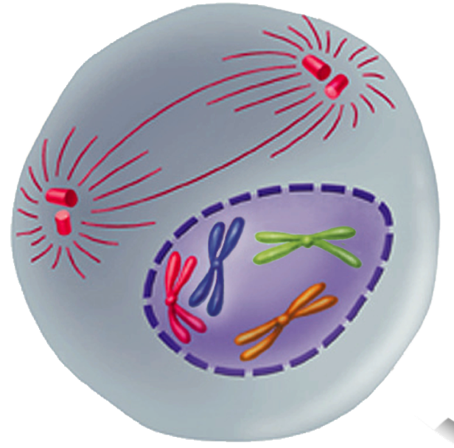
Prophase
Spindle
forming
Prophase is the first and longest phase of mitosis.
Strands of DNA condense and thicken to form visible duplicated chromosomes (sister chromotids).
Sister chromatids are held together by centromeres
The nuclear membrane breaks down.
Centromere
Chromosomes
(paired chromatids)

Slide 25
Prophase
Spindle
forming
The centrioles move to opposite poles of the cell
Spindle fibres begin to form from the centrioles.
Centromere
Chromosomes
(paired chromatids)
Chromatids become visible under the light microscope

Slide 26
Prophase
Animal Cell
Plant Cell
Spindle fibers
Centrioles

Slide 27
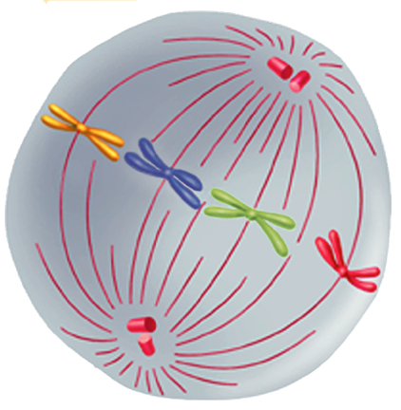
Metaphase
Centriole
The second phase of mitosis.
Spindle fibres connect the centromere of each chromosome to the poles of the spindle.
Spindle fibres help chromosomes line up across the equator (center) of the cell.
Spindle

Slide 28
Metaphase
Animal Cell
Plant Cell

Slide 29
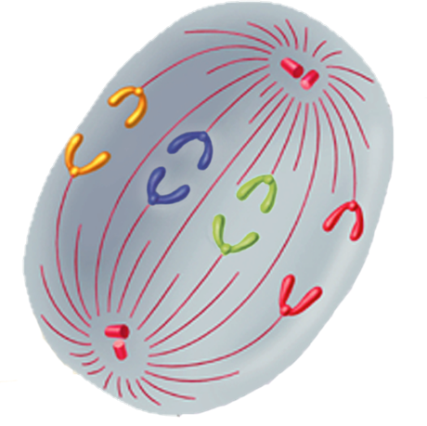
Anaphase
The third phase of mitosis.
Centromeres are split apart
Each chromatid pair splits (each are now called daughter chromosomes).
Spindle fibres shorten and thicken, pulling one chromatid (chromosome) from each spilt pair to opposite poles.
Individual
chromosomes

Slide 30
Anaphase
Animal Cell
Plant Cell

Slide 31
Anaphase

Slide 32
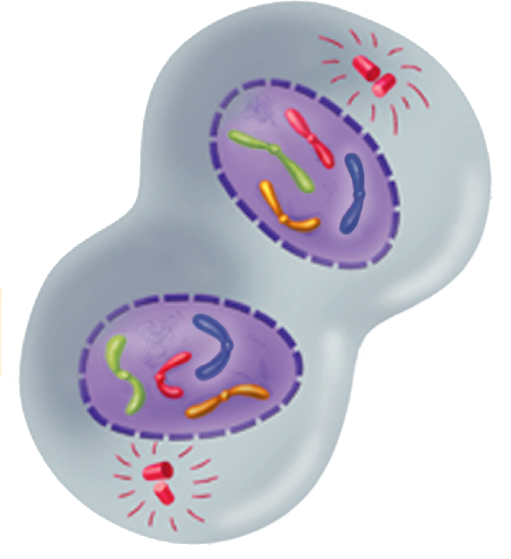
Telophase
The fourth and final phase of mitosis.
Chromosomes gather at opposite ends of the cell. They begin to unwind and are less visible.
Nuclear membrane begins to reform
Spindle fibres begin to break down.

Slide 33
Telophase
Animal Cell
Plant Cell

Slide 34
Cytokinesis in Animals
After mitosis the cytoplasm separates and two identical daughter cells form.

Slide 35
Cytokinesis in Plants
In plants, a structure known as the cell plate forms midway between the divided nuclei.
Cell plate
Cell wall
The cell plate gradually develops into a separating membrane and a cell wall begins to appear.

Slide 36
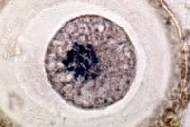
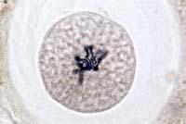
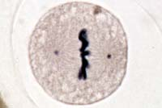
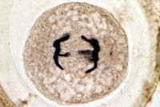
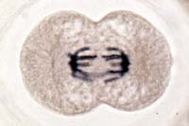
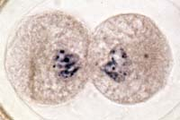
Animal Cell Cycle-- Review
Interphase | Prophase
Metaphase | Anaphase
Telophase | Interphase

Slide 37
Rat – epithelial cells
Prophase
Metaphase
Anaphase
Telophase
Re-watch the video from earlier →

Slide 38
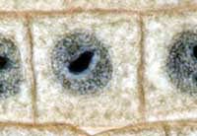
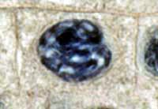
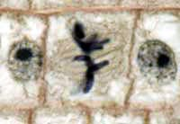
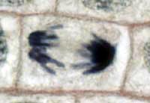
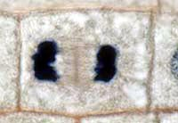
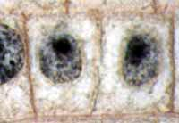
Plant Cell Cycle -- Review
Interphase | Prophase
Metaphase | Anaphase
Telophase | Interphase

Slide 39
Plants

Slide 40
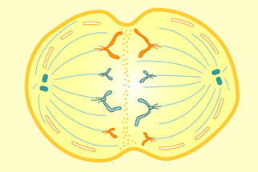
Interactive Cell Division

Slide 41
Checkpoints in the Cell Cycle
A cell will not divide if:
Signals from surrounding cells tell the cell not to divide
There are not enough nutrients to provide for cell growth
The DNA within the nucleus has not been replicated
The DNA is damaged

Slide 42
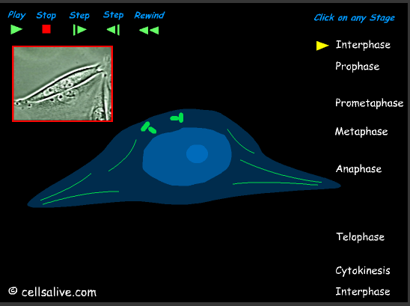
Interactive Cell Division Timing Cell Division
Mitosis Animations -
Click the images to view

Slide 43
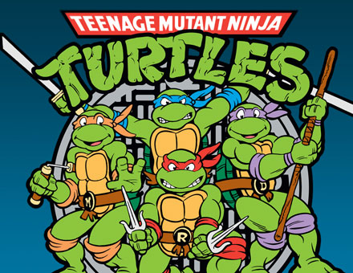
Errors in Mitosis
Substances such as toxic chemicals, radiation and viruses and cause MUTATIONS
Mutations alter the structure of DNA
When these cells divide the mutation is passed ONLY to the daughter cells

Slide 44
Errors in Mitosis
One result of a mutation can cause cells to divide uncontrollably leading to CANCER
Eg. Cigarette smoke can alter the chromosomes in the lungs causing these cells to undergo mitosis much faster than normal
This can lead to Lung Cancer
Healthy Lung Cancerous Lung

Slide 45
Retinoblastoma – Cancer of the Retina (back of the eye)
Retinoblastoma is caused by a mutation to certain genes in the eye which are carried on by mitosis.

