Slide 1
How Ecosystems Work

Slide 2
Life Depends on the Sun
Photosynthesis is the process by which plants, algae, and some bacteria use sunlight, carbon dioxide, and water to produce carbohydrates and oxygen

Slide 3
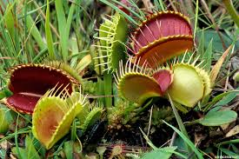
From Producers to Consumers
A producer is an organism that can make organic molecules from inorganic molecules
Producers are also called autotrophs, or self-feeders
Chemoautotrophs

Slide 4
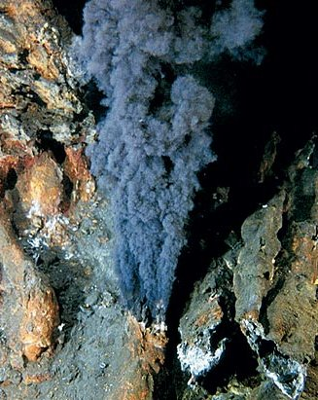
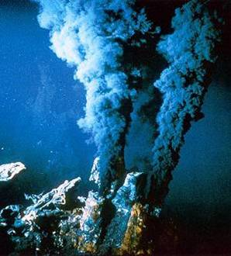

Slide 5
From Producers to Consumers
A consumer is an organism that eats other organisms or organic matter instead of producing its own nutrients or obtaining nutrients from inorganic sources
Consumers are also called heterotrophs, or other-feeders

Slide 6
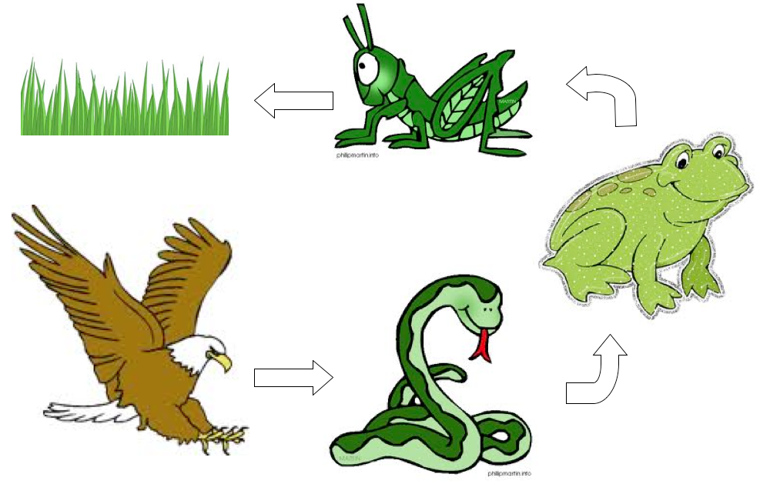

Slide 7
What Eats What?
Organisms can be classified by what they eat
Types of Consumers:
Herbivores
Carnivores
Omnivores
Decomposers

Slide 8
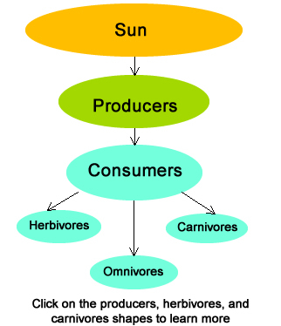

Slide 9
Burning the Fuel
The process of breaking down food to yield energy is called cellular respiration

Slide 11
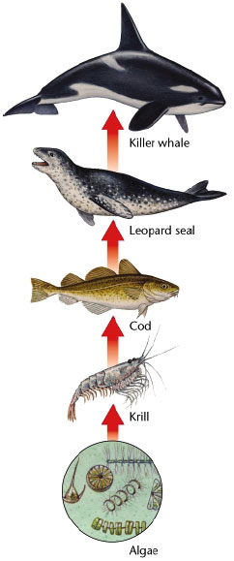
Food Chains
A food chain is a sequence in which energy is transferred from one organism to the next as each organism eats another organism

Slide 12
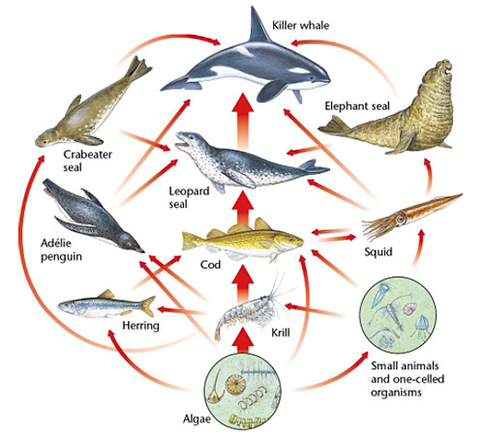
Food Webs
A food web shows many feeding relationships that are possible in an ecosystem

Slide 13
Trophic Levels
A trophic level is one of the steps in a food chain or food pyramid; examples include producers and primary, secondary, and tertiary consumers
10% rule

Slide 14
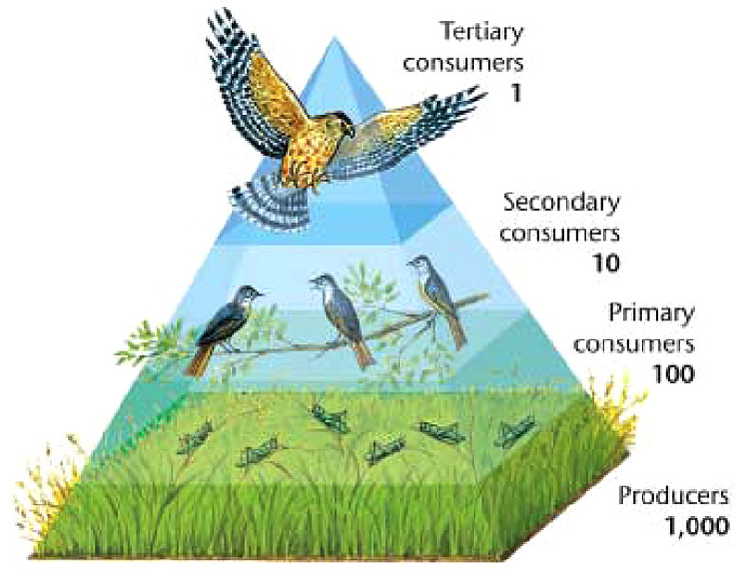
Trophic Levels

Slide 15
The Carbon Cycle
The carbon cycle is the movement of carbon from the nonliving environment into living things and back

Slide 16
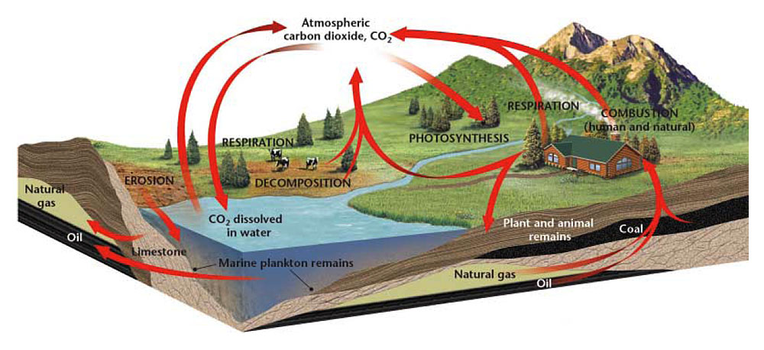
The Carbon Cycle

Slide 17
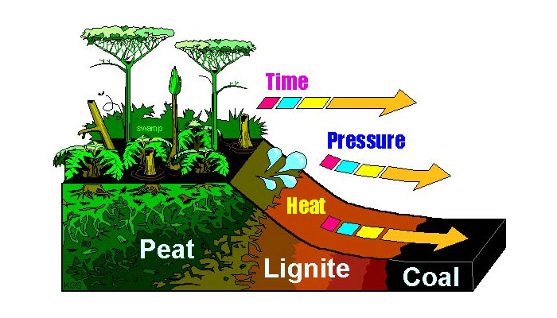

Slide 18
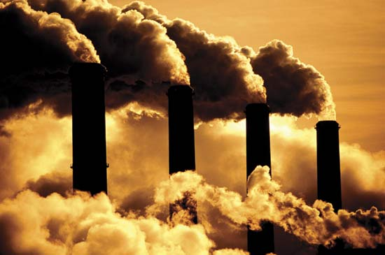
How Humans Affect the Carbon Cycle
Humans burn fossil fuels, releasing carbon into the atmosphere
The carbon returns to the atmosphere as carbon dioxide
Climate change

Slide 19
The Nitrogen Cycle
The nitrogen cycle is the process in which nitrogen circulates among the air, soil, water, plants, and animals in an ecosystem
Nitrogen makes up 78% of the gases in the atmosphere

Slide 20
The Nitrogen Cycle
Nitrogen-fixing bacteria are bacteria that convert atmospheric nitrogen into ammonia
Live on plants called legumes
Beans, peas, peanuts
“fix” nitrogen to a solid form that is stored in plants and passed up the food chain

Slide 21
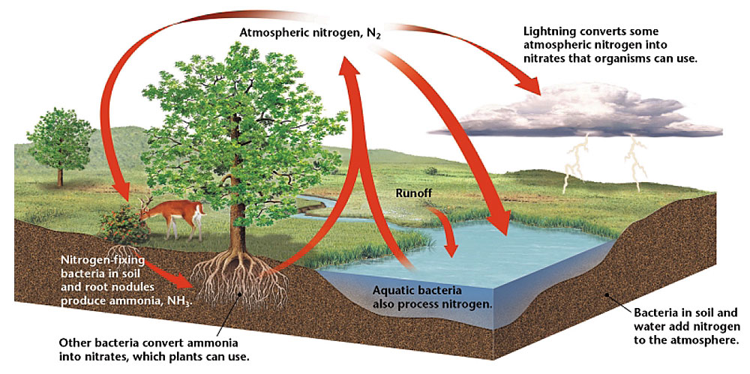
The Nitrogen Cycle

Slide 22
The Phosphorus Cycle
The phosphorus cycle is the cyclic movement of phosphorus in different chemical forms from the environment to organisms and then back to the environment
Fertilizers put excess phosphorus and nitrogen into ecosystems

Slide 23
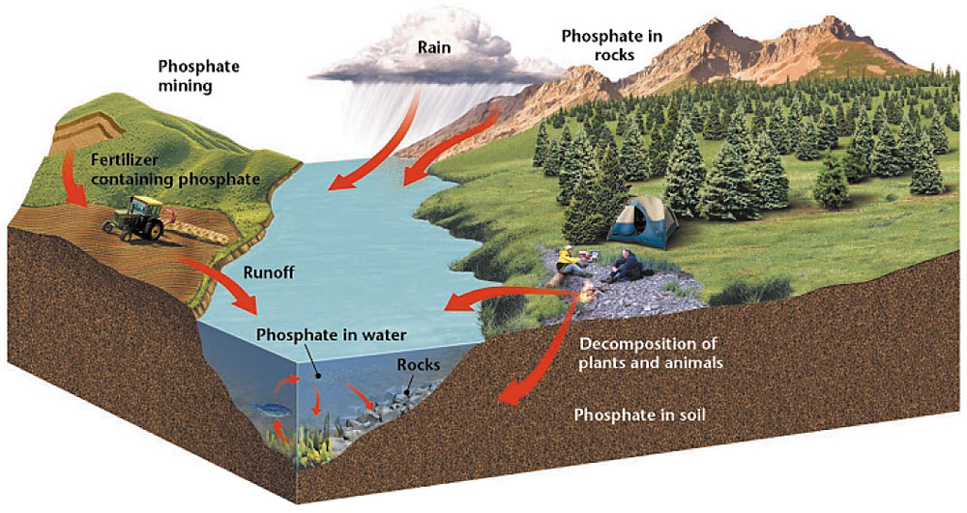
The Phosphorus Cycle

Slide 25
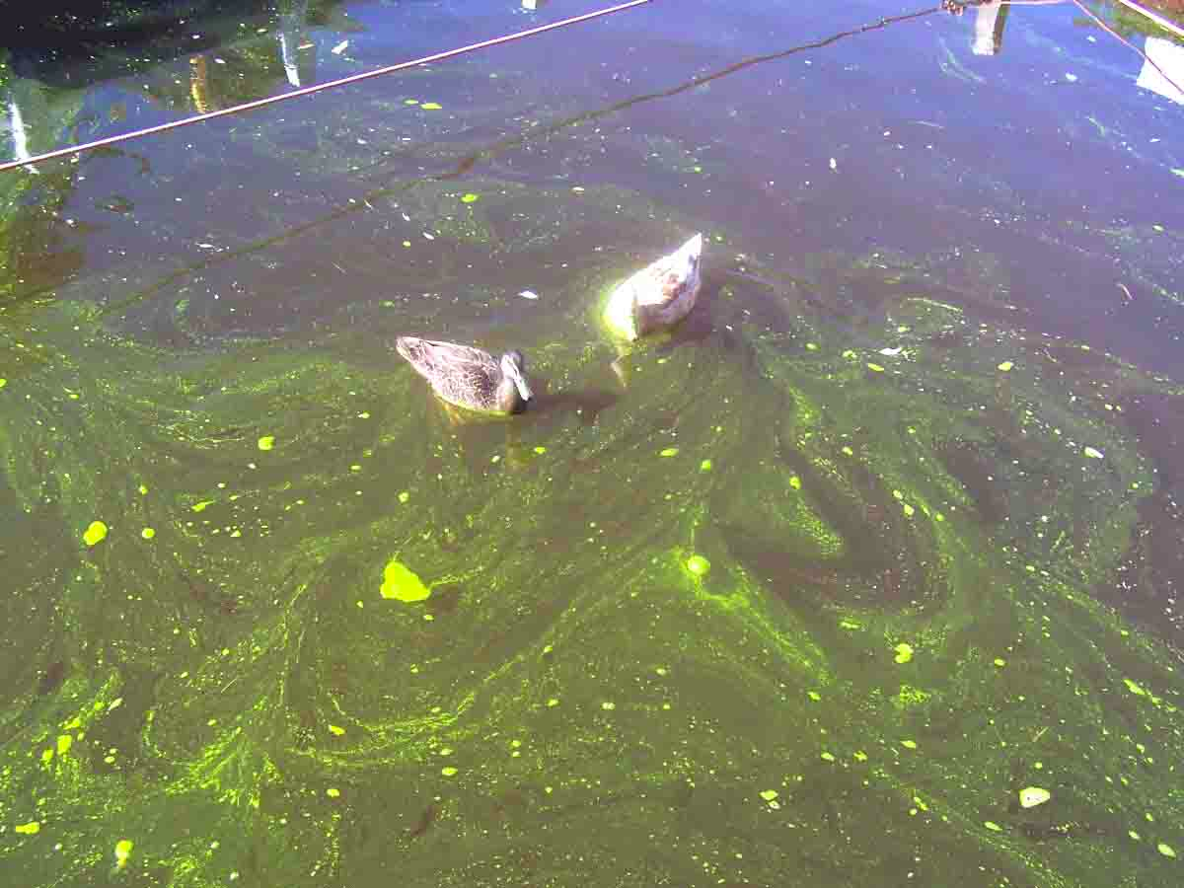

Slide 26
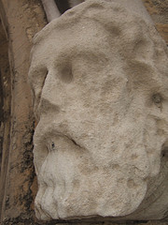
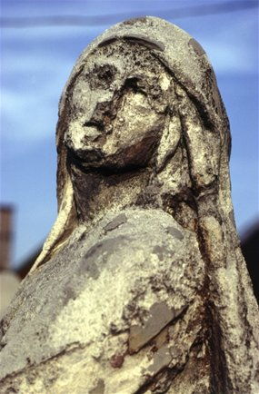
Acid Precipitation
When fuel is burned, large amounts of nitric oxide is release into the atmosphere

Slide 27
Ecological Succession
Ecological succession is a gradual process of change and replacement of the types of species in a community
Each new community that arises often makes it harder for the previous community to survive
Primary (happens where there IS NOT soil)
Rocks, glaciers
Secondary succession (soil IS present)
Fires, farmland, stores

Slide 28
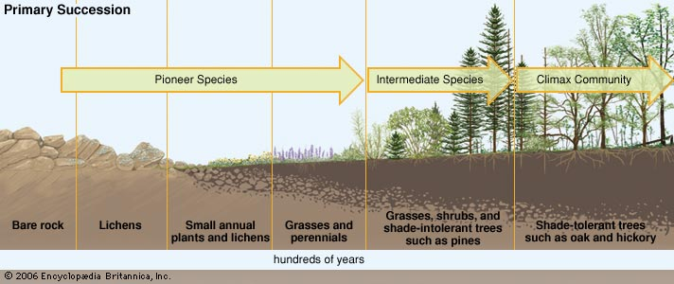

Slide 29
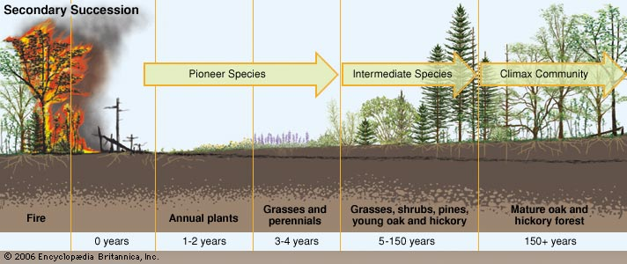

Slide 30
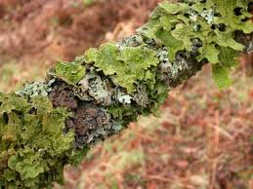
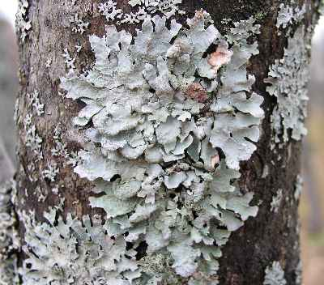
Ecological Succession
A pioneer species starts life (mosses and lichens)
A climax community stable community

