Slide 1
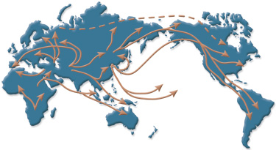
migration
The movement of individuals into, out of or between populations. This movement will permanently change the gene pool and is not just done for nesting sites

Slide 2
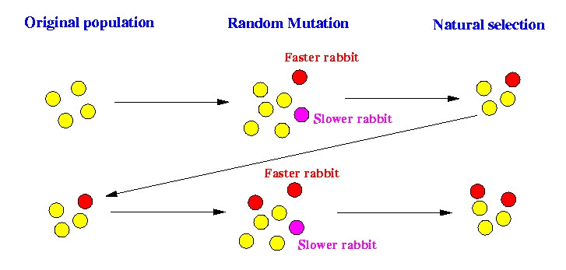
Mutation
Mutation can change the alleles in a gene pool.

Slide 3
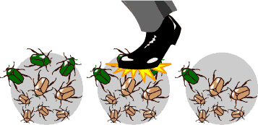
Genetic drift
Random changes in allele frequency that occurs in small populations. May cause movement in and out.
“founder effect”
Populations may move into a new area reducing the alleles they carry with them.

Slide 4
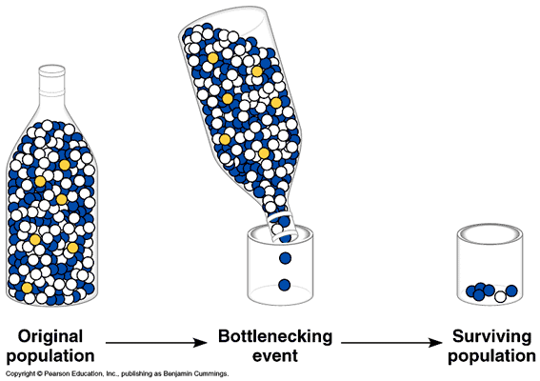
Bottle Neck Effect
The Bottleneck Effect occurs when there is a disaster of some sort that reduces a population to a small handful, which rarely represents the actual genetic makeup of the initial population. This leaves smaller variation among the surviving individuals.

Slide 5
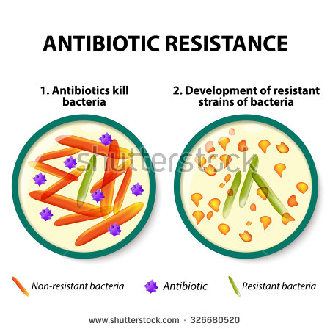
Biological Resistance
The effect of an organism that can avoid being killed because of an adaptation of the species.

Slide 6
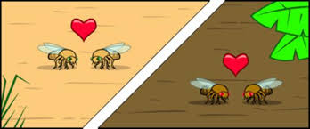
Reproductive isolation
A state in which two population can no longer interbreed to produce future offspring

Slide 7
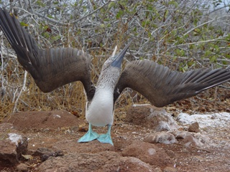
Mating Behavior and timing
If two populations develop differences in timing or matting behavior they may no longer attract a mate
bird of paradise

Slide 8
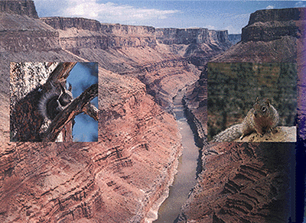
Geography
A physical barrier prevents interbreeding.

Slide 9
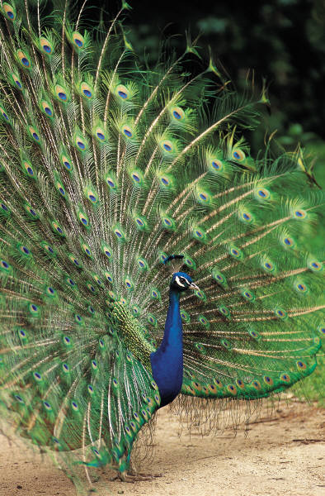
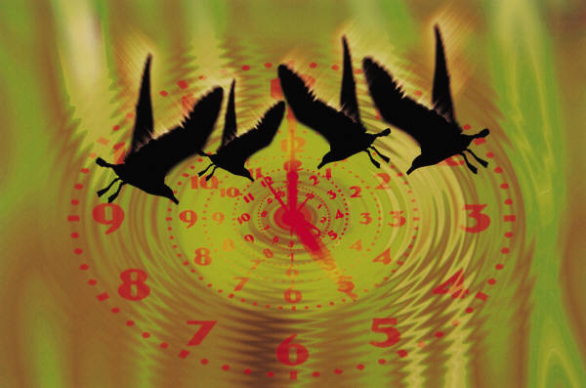
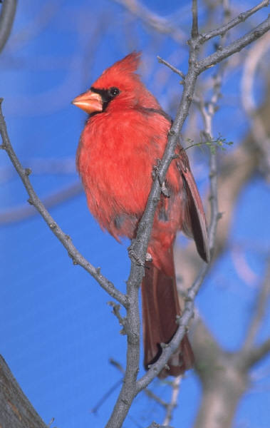
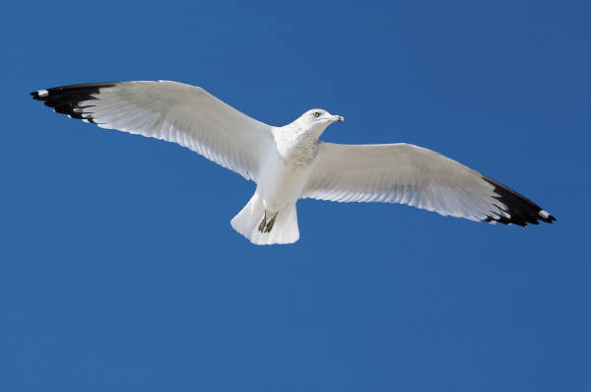
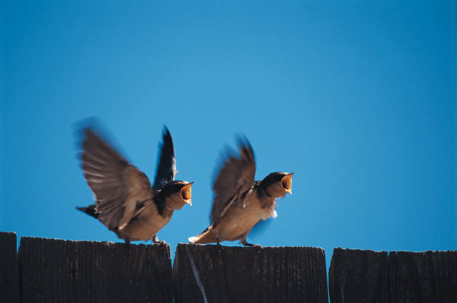
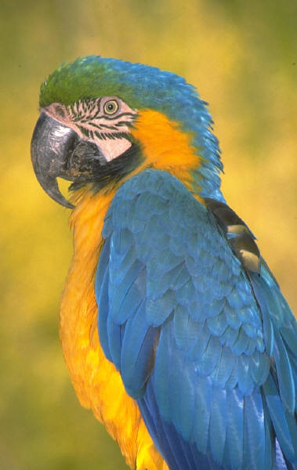
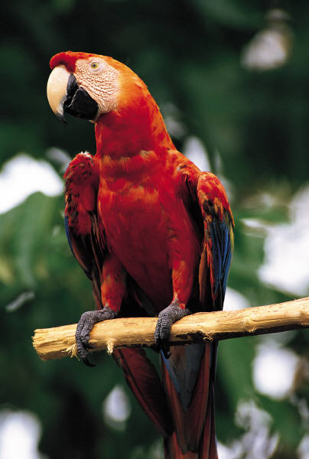
Speciation Mechanisms
25
Behavioral Isolation
Populations are capable of interbreeding, but have different courtship rituals or other type of behavior.
Geographic Isolation
Separated by bodies of water or mountains.
Temporal Isolation
Reproduction takes place at different times of the year
Overtime they can change so much that they become unable to breed as they adapt to their environment.

